Slide 1


Work Smarter with SOPs
Colleen Unema
Owner / Teacher / Launderer
Laundry University
#washdryfold

Slide 2

SOPs for WDF
Effective Use of Technology to Manage our WDF Business
How to create Standard Operating Procedures for WDF
Standardizing your Pathways so Your People Know What to Do
Getting the Message to Your People
Help! So Many Systems, So Little Time

Slide 3


Slide 4

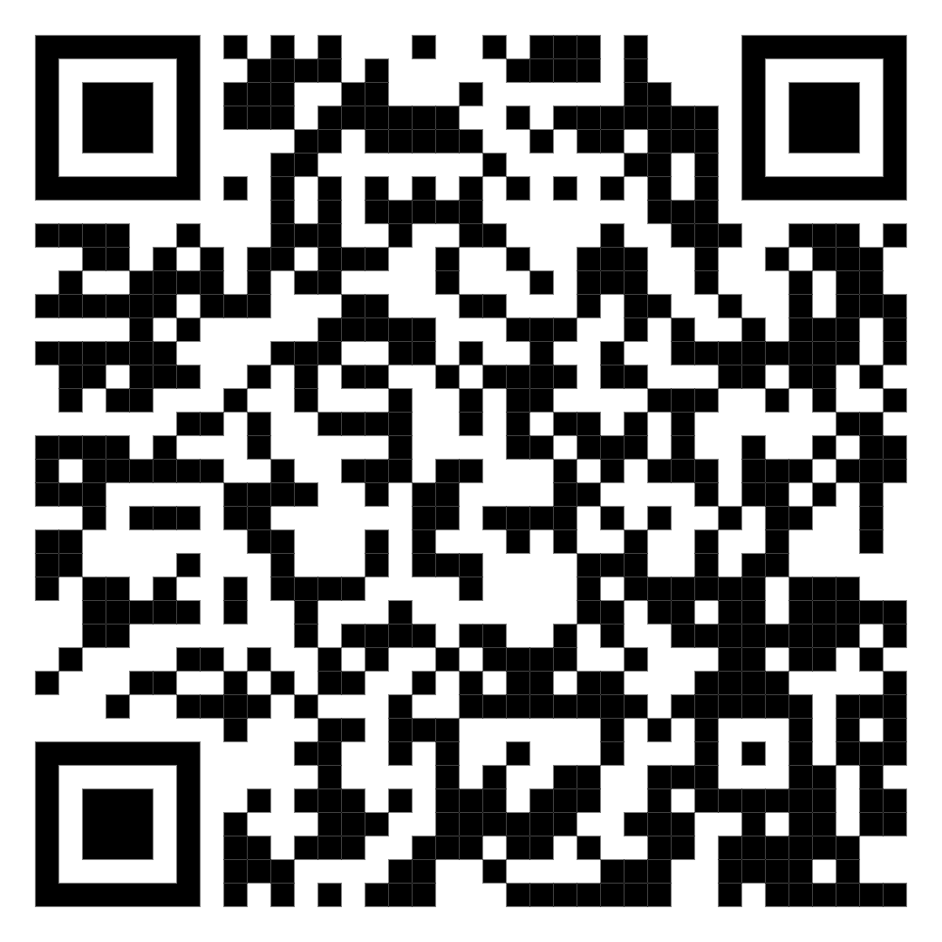
The US Chamber of Commerce Newsletter for Small Business Owners.
#washdryfold

Slide 5
Bureau of Labor Statistics has a Newsroom.
#washdryfold

Slide 6
Edward Lowe Foundation has a Digital Library.
#washdryfold

Slide 7

Kristina Stubblefield of AI Simplified has a Podcast, Social Community
#washdryfold

Slide 8
Boomers * Gen X * Millenials * Gen Z
62% report leaving their existing retail job in the next 12 months
Flexibility (schedules / flex time / micro-retirement)
Social Responsibility
Opportunity for Training / Personal Development (not necessarily for leadership advancement)
Digital Communication, Training, Standards (small content / visual format)

Slide 9
Standardizing Our Pathways* (SOP) to Success.
Standardizing
Our
Pathway
*Standardizing Our Pathway (SOP) is the same as Standard Operating Procedures (SOP).

Slide 10


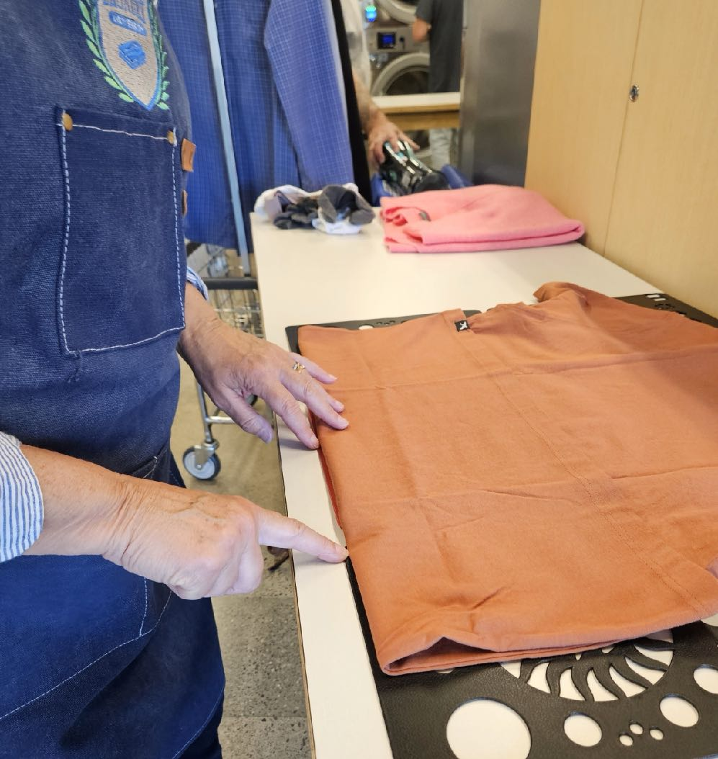
SOP
Standardize Our Pathway
OR

Slide 11
SOP Life Cycle
Perfect World
Our World
Identify Goal or Success
Goal Known only to Owner/Manager
Task / Operational Instructions
Identify Task Choices
Chart Choices
Chart Outcomes by each Choice
“Don’t do THAT!”
Script Each Choice
“Do It THIS Way”
Achieve Success, Goal
Sometimes…Achieve Goal

Slide 12
Improvisation vs. Innovation
IMPROVISATION is a made-up solution pathway for immediate outcome that only
the improvisor knows
INNOVATION is a creative solution pathway toward a known outcome goal

Slide 13
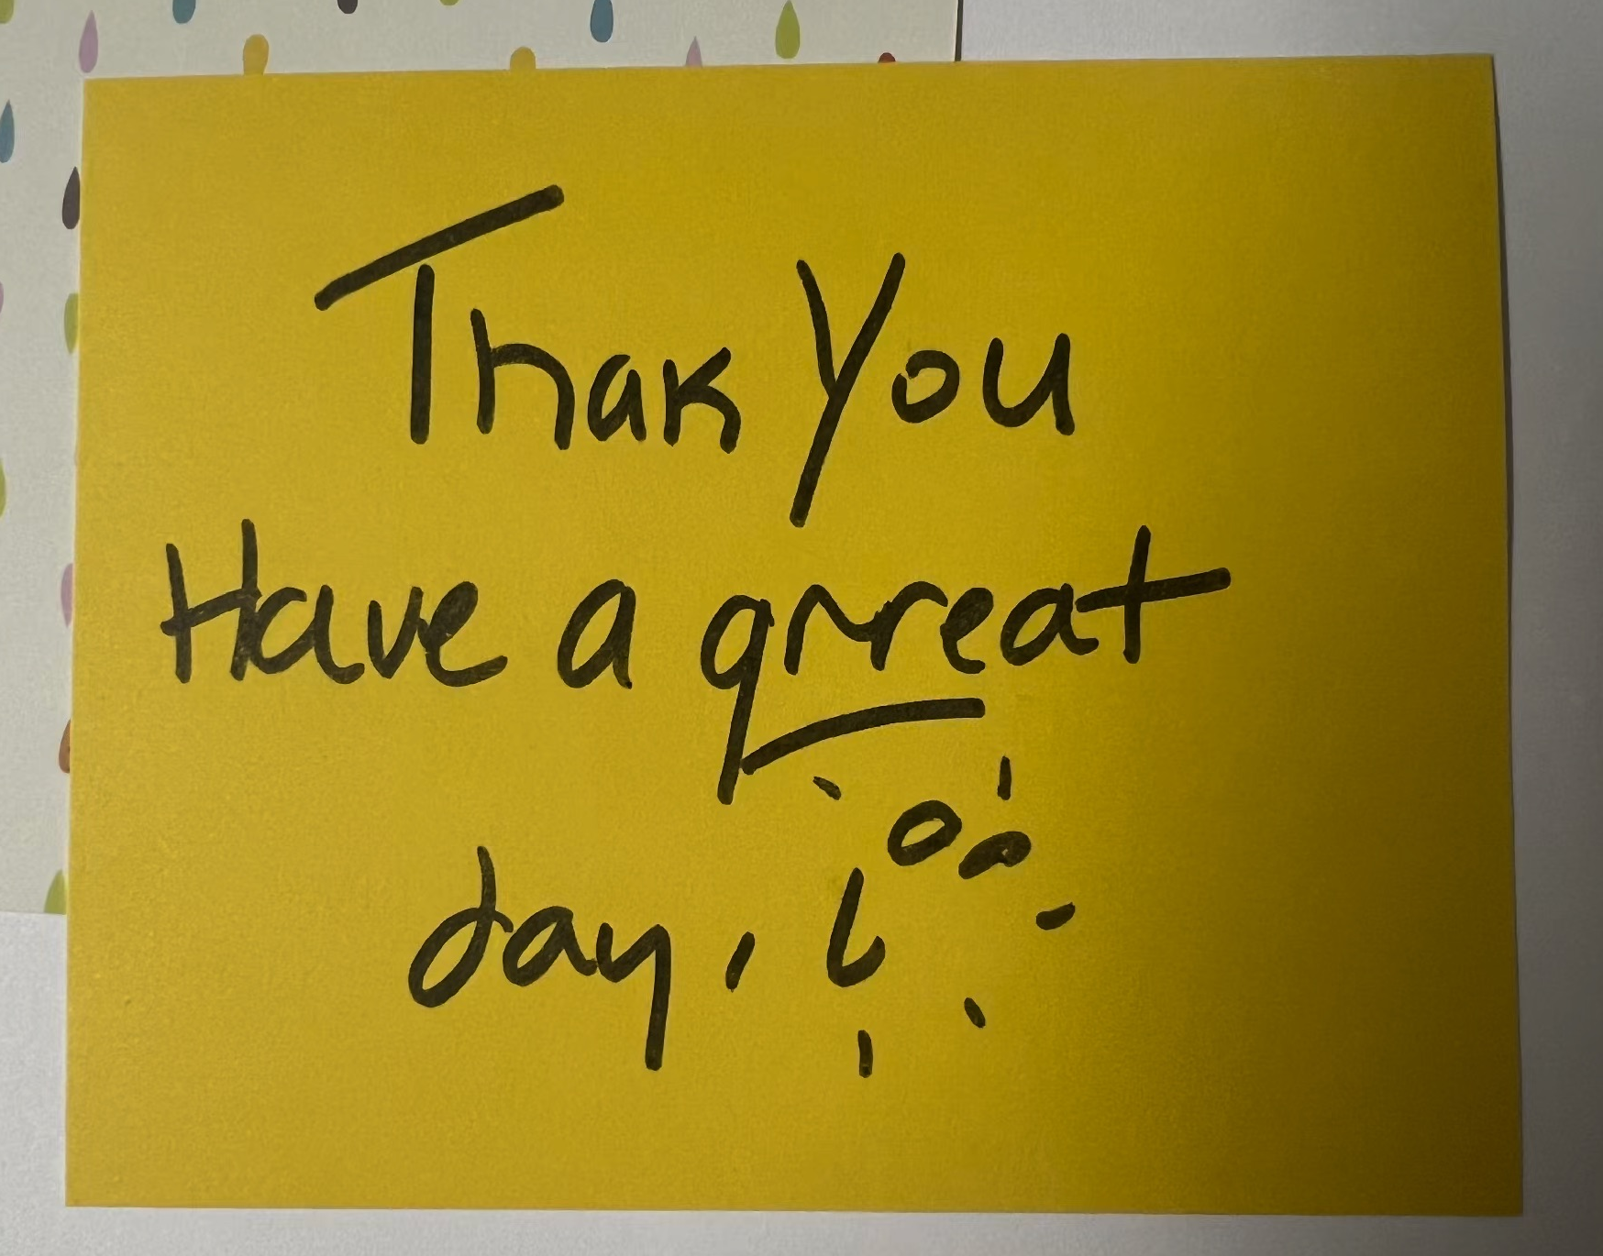
Improvisation looks like this:

Slide 14

Improvisation sounds like this:

Slide 15
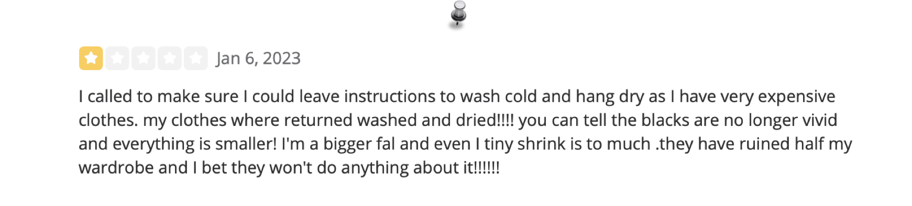
Improvisation reads like this:

Slide 16
Improvisation feels
like this:

Slide 17







Why do you need SOPs?

Slide 18

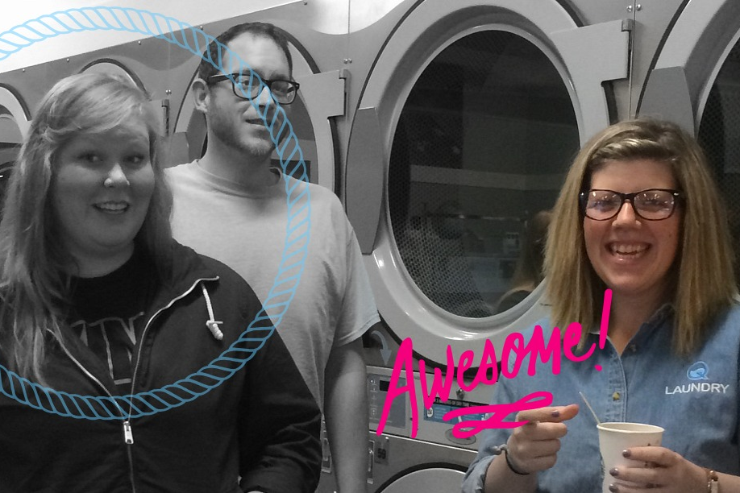
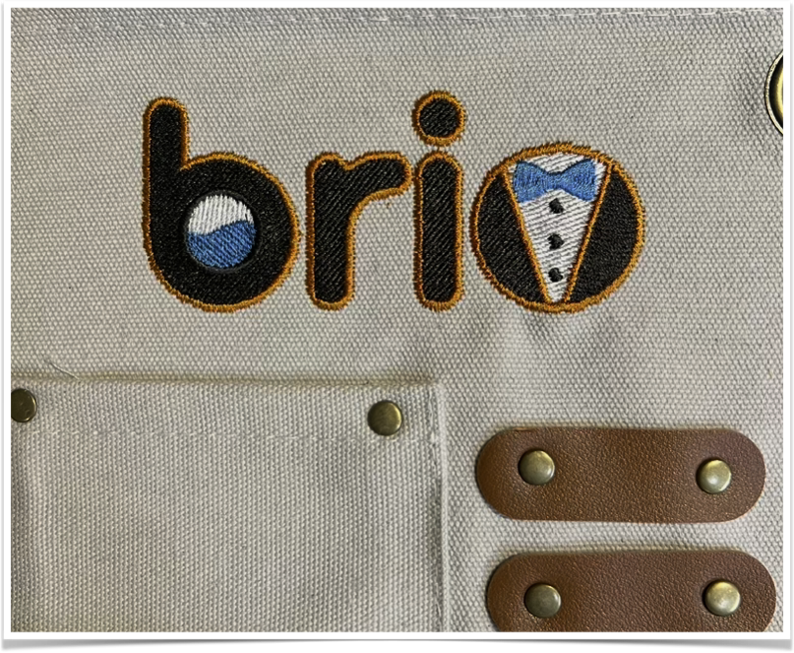

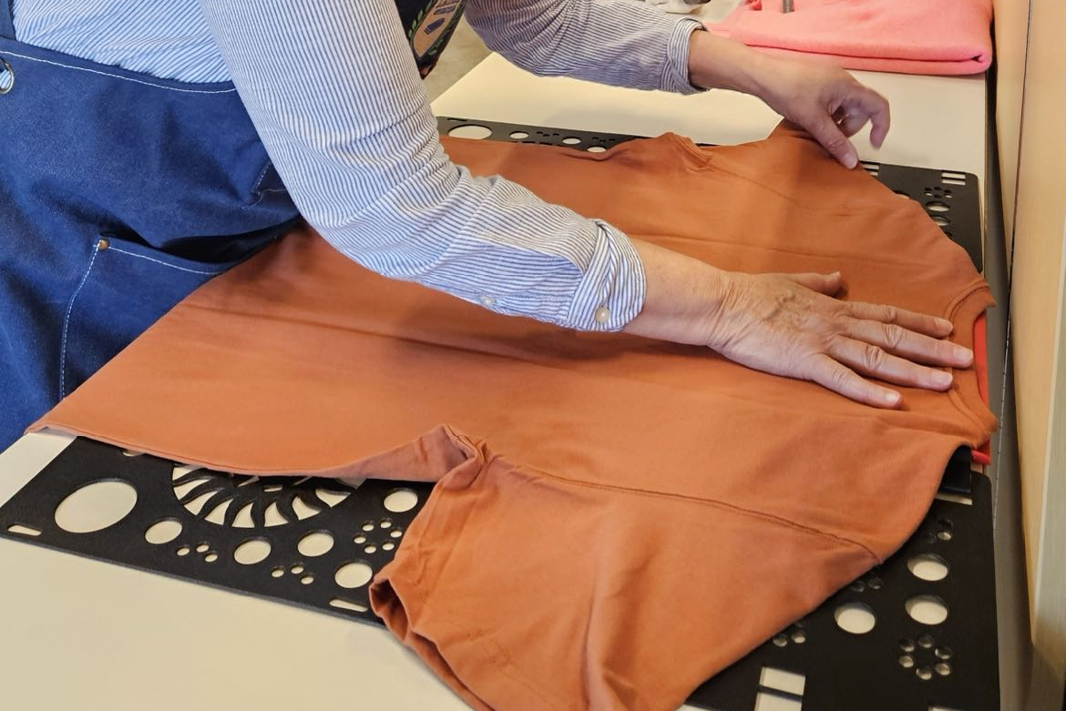
Why do your Employees need SOPs?
INNOVATION

Slide 19

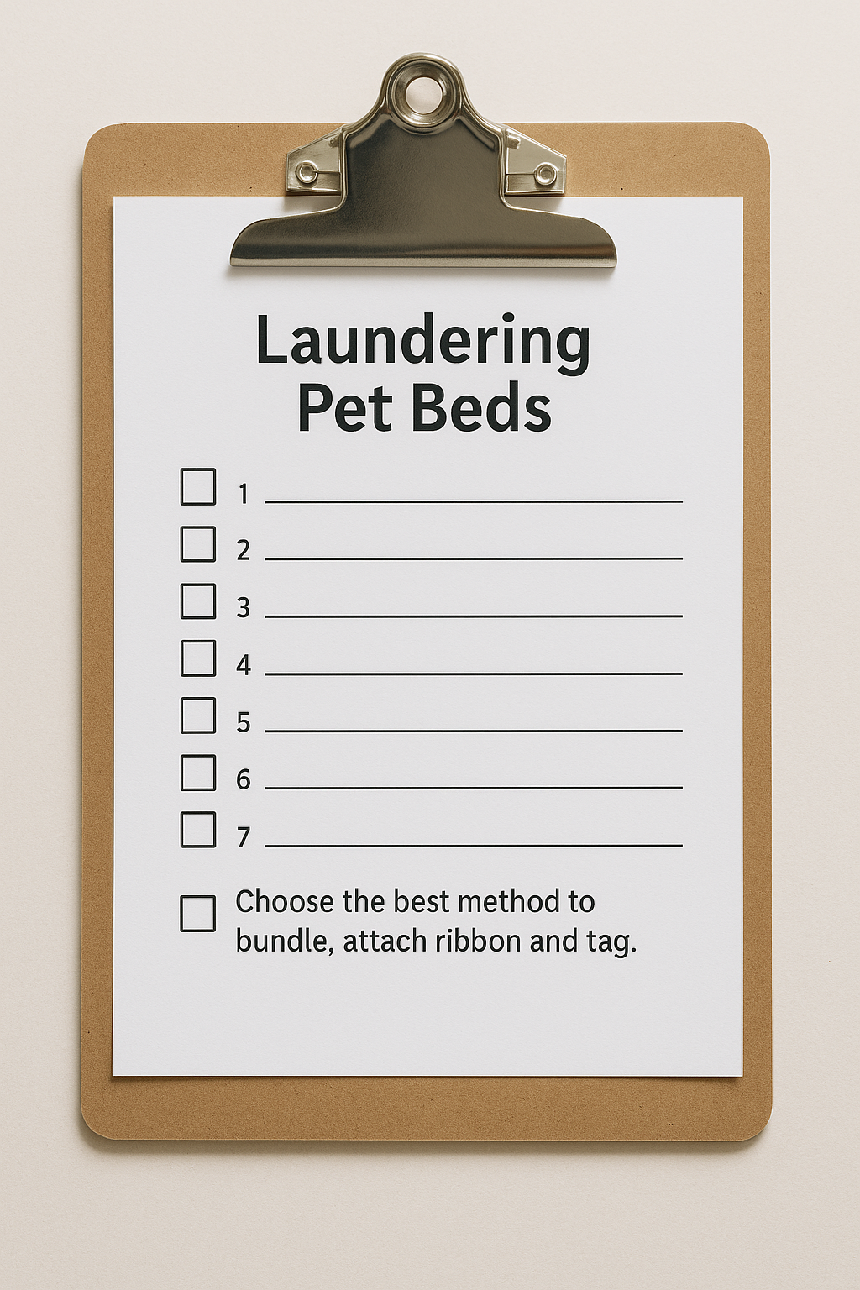
Notes:
On the left is a checklist of tasks to accomplish. On the right are the steps to achieve the result. The steps, or methods, must be followed in order to achieve the desired outcome.

Slide 20
Methods
Designated starting point.
A one-way path to success.
Designated finish.
#washdryfold
Notes:
When there is a method to follow for a successful finish, break it down into steps. Each step must be followed. Having steps allows you to pinpoint where a problem occurred. It also allows people to change, one can pick up where the other left off (say, a shift change).

Slide 21
Methods
Designated starting point.
All pet beds are laundered after 7 pm and before last customer load.
A one way path to success.
Use our SOP for laundering pet beds.
Designated finish.
Choose how to bundle, attach note and tag.
#washdryfold
Notes:
Every single outcome that you have standards for need a designated start point and a designated finish.

Slide 22
Methods
Designated starting point.
All pet beds are laundered after 7 pm or last customer load.
A one way path to success.
Use our SOP for laundering pet beds.
Designated finish.
Choose how to bundle, attach note and tag.
Methods are a great place to build in choice and innovation.
#washdryfold
Notes:
Notice how the final step gives the launderer choice. They can choose the appropriate bundling option, the personal note and message.

Slide 23
Methods
Designated starting point.
A one way path to success.
Designated finish.
Choice or improvisation in the pathway is usually the cause of quality control issues.
#washdryfold
Notes:
Most Quality Control issues happen somewhere in the middle of the process.
They may have performed “good enough” for weeks, then one day their output is subpar. Do you let it go, do you tell them to redo it? Then you wonder about all the orders you did not see….and your confidence wanes.

Slide 24
SOP Life Cycle
Perfect World
Our World
Identify Goal or Success
Goal Known only to Owner/Manager
Task / Operational Instructions
Identify Task Choices
Chart Choices
Chart Outcomes by each Choice
“Don’t do THAT!”
Script Each Choice
“Do It THIS Way”
Achieve Success, Goal
Sometimes…Achieve Goal

Slide 25
Which Operations Should I Focus On?
②
Read Your Reviews
③
Time Hogs and Direct Supervision Demands
①
Decide which Operations can be CHECK-LISTED
and which ones need a METHOD.

Slide 26
1
How to Make an SOP
2
3
Identify Goal
Pathway to Success
Goal Achieved
Telephone Customer
has their Question(s)
Answered
Every Phone Customer is
Satisfied

Slide 27



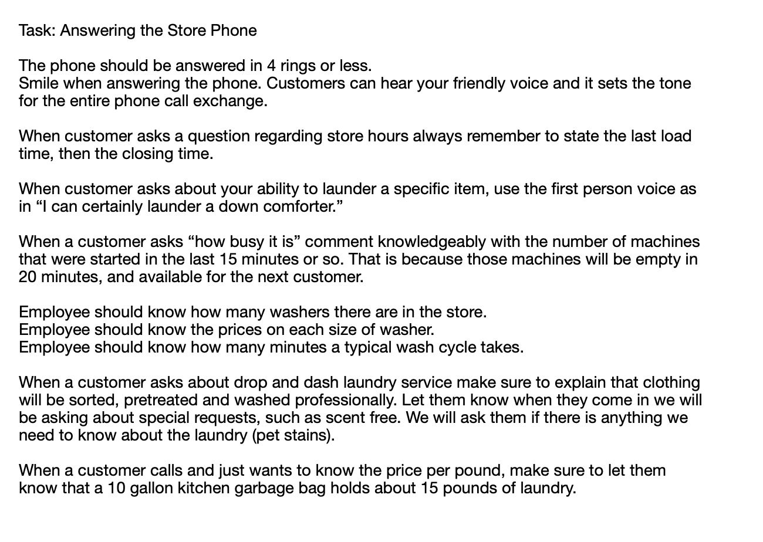

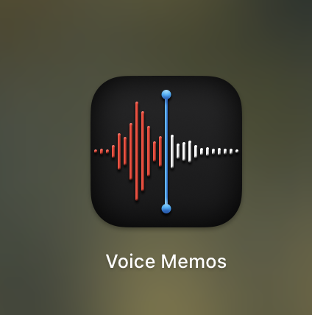
Generate SOP Content
Typed into Document
Voice Memo
Here's the information for an SOP for answering the phone the phone should be answered in four rings or less smile when answering the phone. Customers can hear your friendly voice and it sets the tone for the whole message or the whole call exchange. When a customer asks a question regarding store hours, always remember to state the last load time, then the closing time. When your customer asks about your ability to launder a specific item, use the first-person voice, as in, I can certainly launder a down comforter. When a customer asks how busy it is, comment knowledgeably with a number of machines that were started in the last 15 minutes or so. This is because those machines will be empty in 20 minutes and available for that next customer. Employees should know how many washers there are in the store. They need to know the prices on each size of washer. Employees should know how many minutes a typical wash cycle takes. When customer asks about drop and dash laundry service, make sure to explain that clothing will be sorted, pre treated, and washed professionally. Let them know when they come in, they'll be asking about we would be asking about special requests, such as sent free dive-free stains. We'll ask them if there's anything we need to know about the laundry. When a customer calls and just wants to know the price per pound, make sure to let them know that a 10 gallon kitchen garbage bag holds about 15 pounds of laundry.
15 minutes at computer
2 minutes on phone

Slide 28


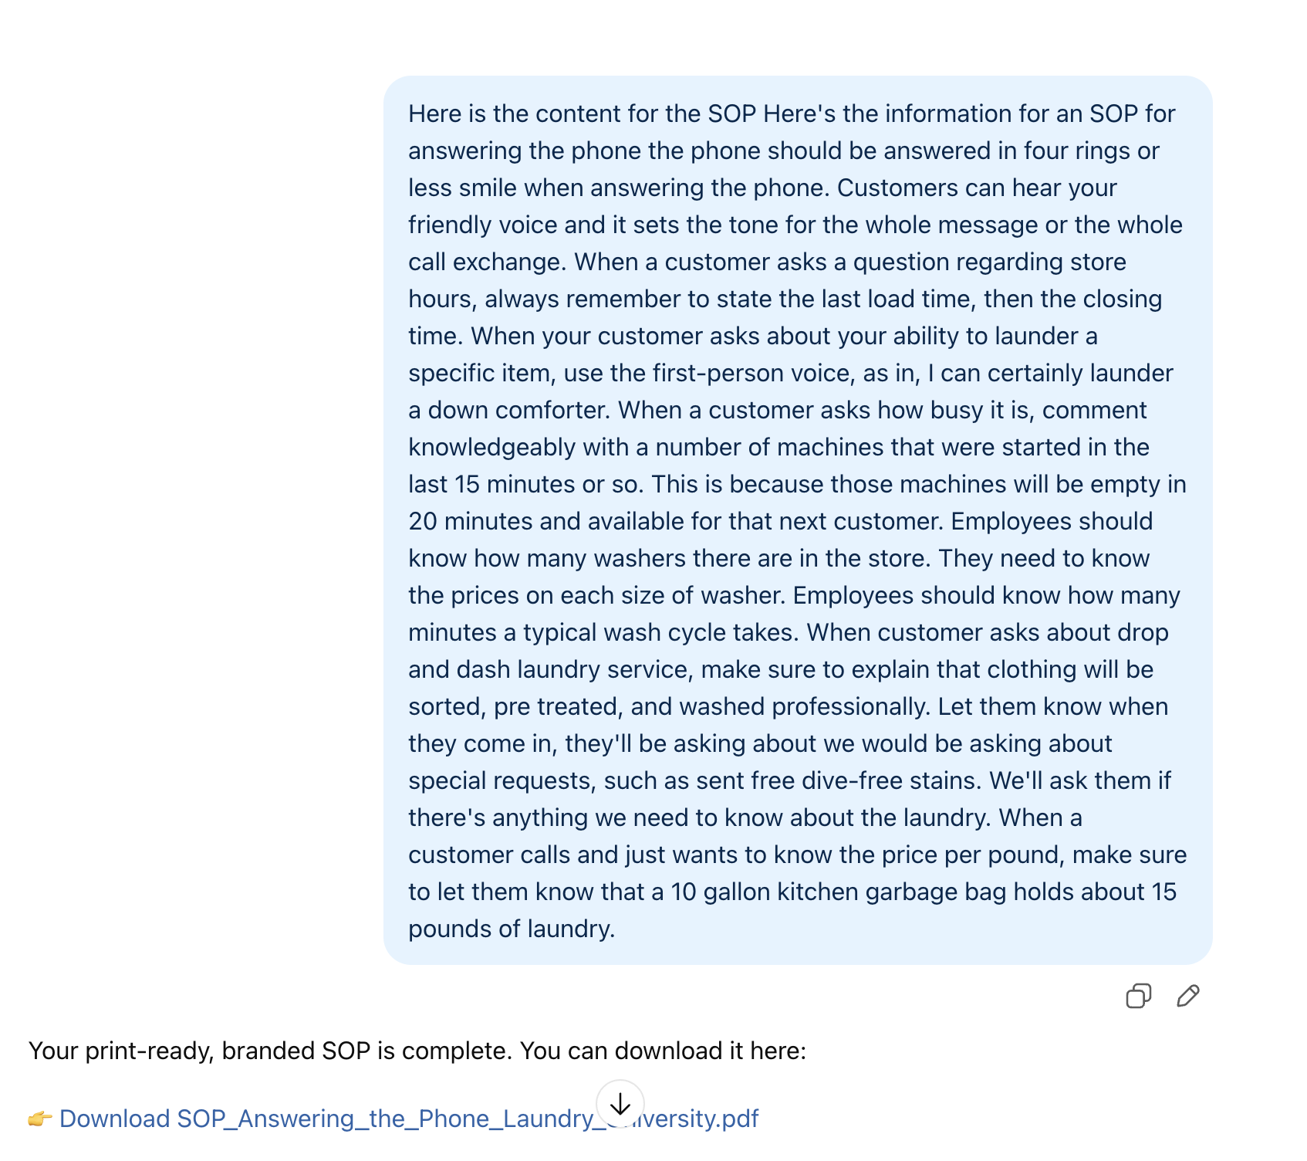





Format using AI
Use a Voice Memo app on your phone:
Paste the Transcript into ChatGPT:
Here's the information for an SOP for answering the phone the phone should be answered in four rings or less smile when answering the phone. Customers can hear your friendly voice and it sets the tone for the whole message or the whole call exchange. When a customer asks a question regarding store hours, always remember to state the last load time, then the closing time. When your customer asks about your ability to launder a specific item, use the first-person voice, as in, I can certainly launder a down comforter. When a customer asks how busy it is, comment knowledgeably with a number of machines that were started in the last 15 minutes or so. This is because those machines will be empty in 20 minutes and available for that next customer. Employees should know how many washers there are in the store. They need to know the prices on each size of washer. Employees should know how many minutes a typical wash cycle takes. When customer asks about drop and dash laundry service, make sure to explain that clothing will be sorted, pre treated, and washed professionally. Let them know when they come in, they'll be asking about we would be asking about special requests, such as sent free dive-free stains. We'll ask them if there's anything we need to know about the laundry. When a customer calls and just wants to know the price per pound, make sure to let them know that a 10 gallon kitchen garbage bag holds about 15 pounds of laundry.

Slide 29

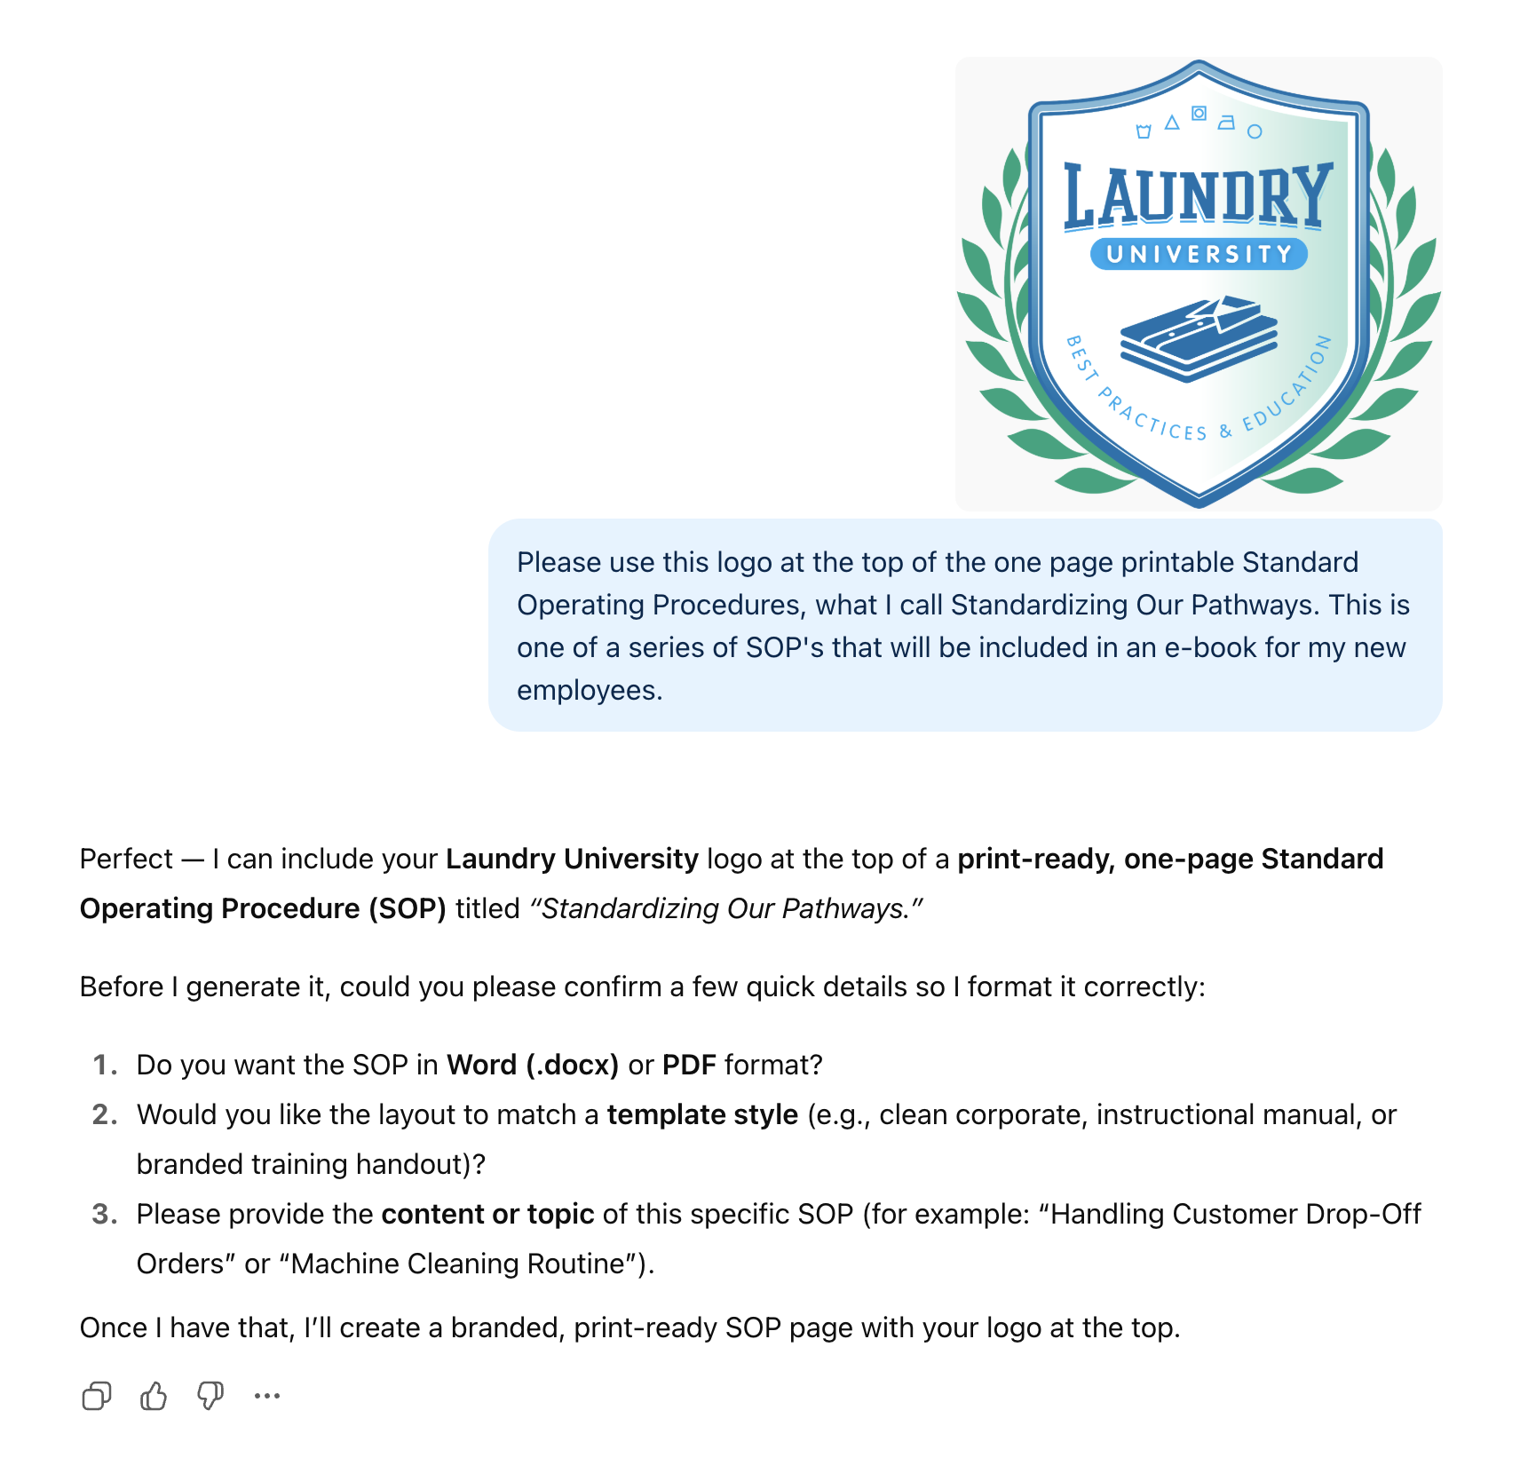
Inputs into AI / ChatGPT

Slide 30
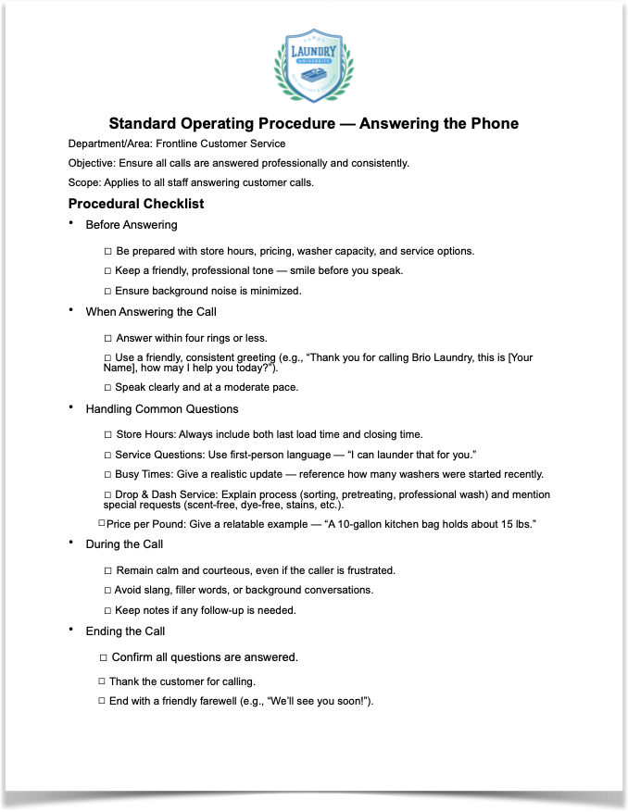
Downloaded Document

Slide 31

SOP Formats
Digital File
Printed / Modular
QR Code
E-booklet
Videos
Training Events
Notes:
emailed by link, hosted on POS or Schedule software, searchable by topic if have a table of contents, printed)

Slide 32

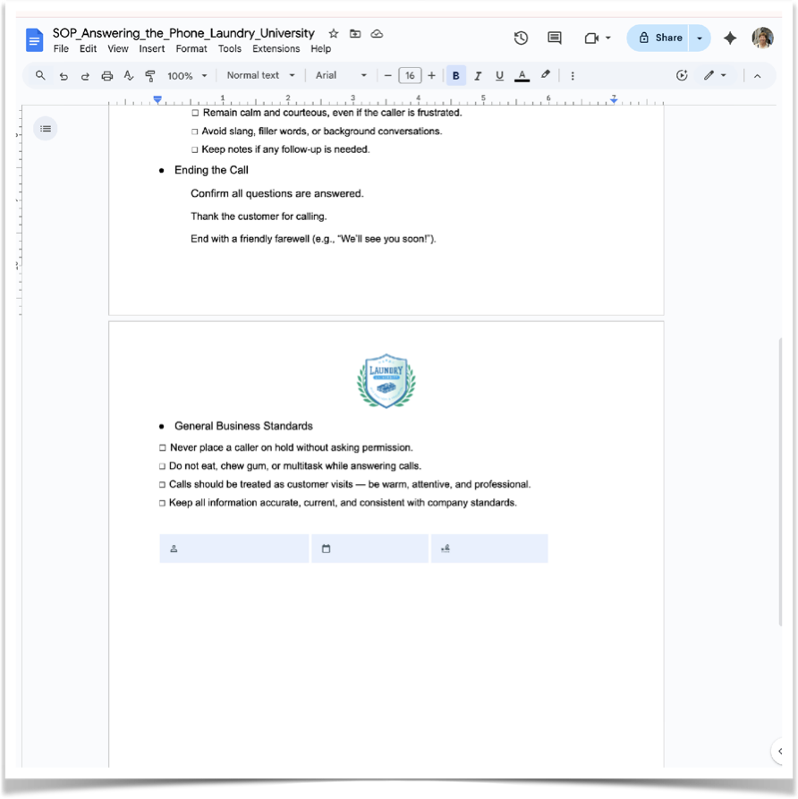



Format #1 Digital File
1. Download your ChatGPT Document
2. Open in Word Processor & Save
3. Upload to Google Drive
4. When you open a Word Doc in Google Drive
it will be converted to Google Doc
5. Tools > E-signature > Share to Employee
Google Docs

Slide 33

Format #2 Printed PDF
1. Download your ChatGPT Document
2. Upload to your Word Processor
3. Export > PDF
4. Print as Needed

Slide 34


Format #3 QR code
1. Download your ChatGPT Document
2. Open in Word Processor & Save
3. Upload to Google Drive
4. When you open a Word Doc in Google Drive it will be converted to a Google Doc
5. Open document > Share > Anyone with Link > Copy Code
6. Paste Code into QR Generator
QR code Chimp

Slide 35
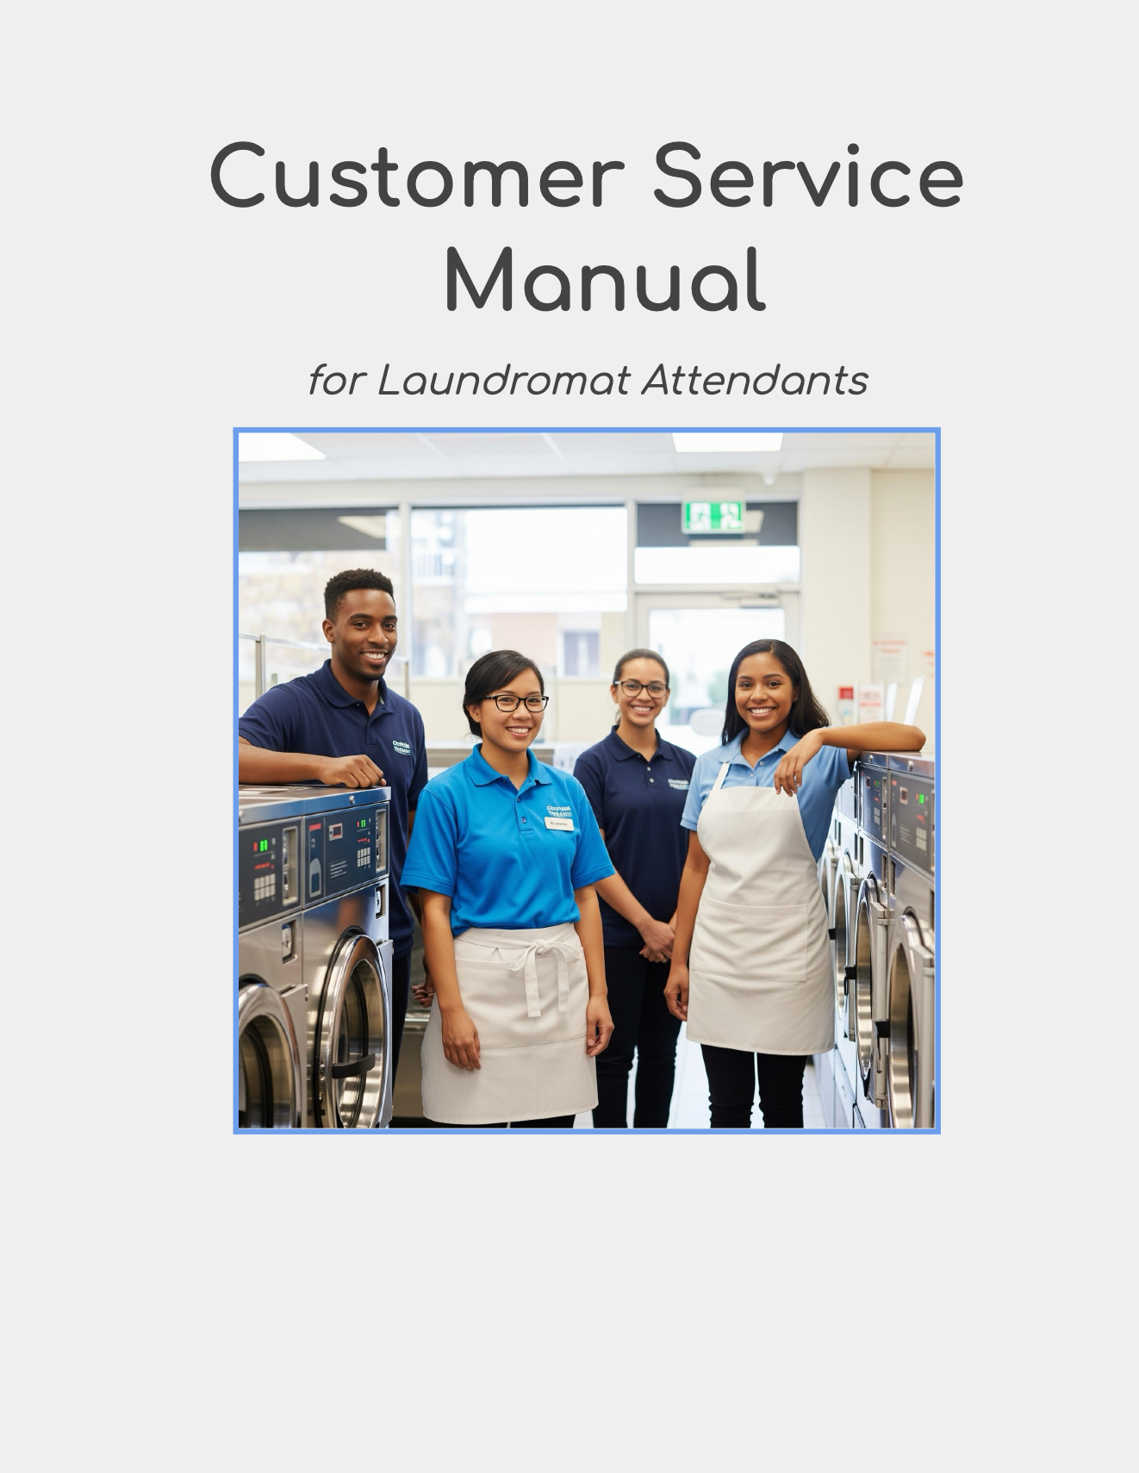

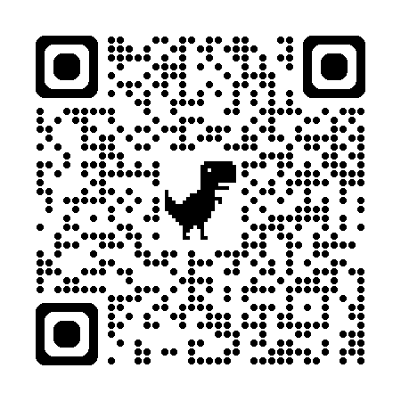
Format #4: E-booklet or Flipbook
1. Download your ChatGPT Document
2. Open in Word Processor & Save
3. Upload to Google Drive
4. When you open a Word Doc in Google Drive
it will be converted to Google Doc
5. Tools > E-Pub

Slide 36
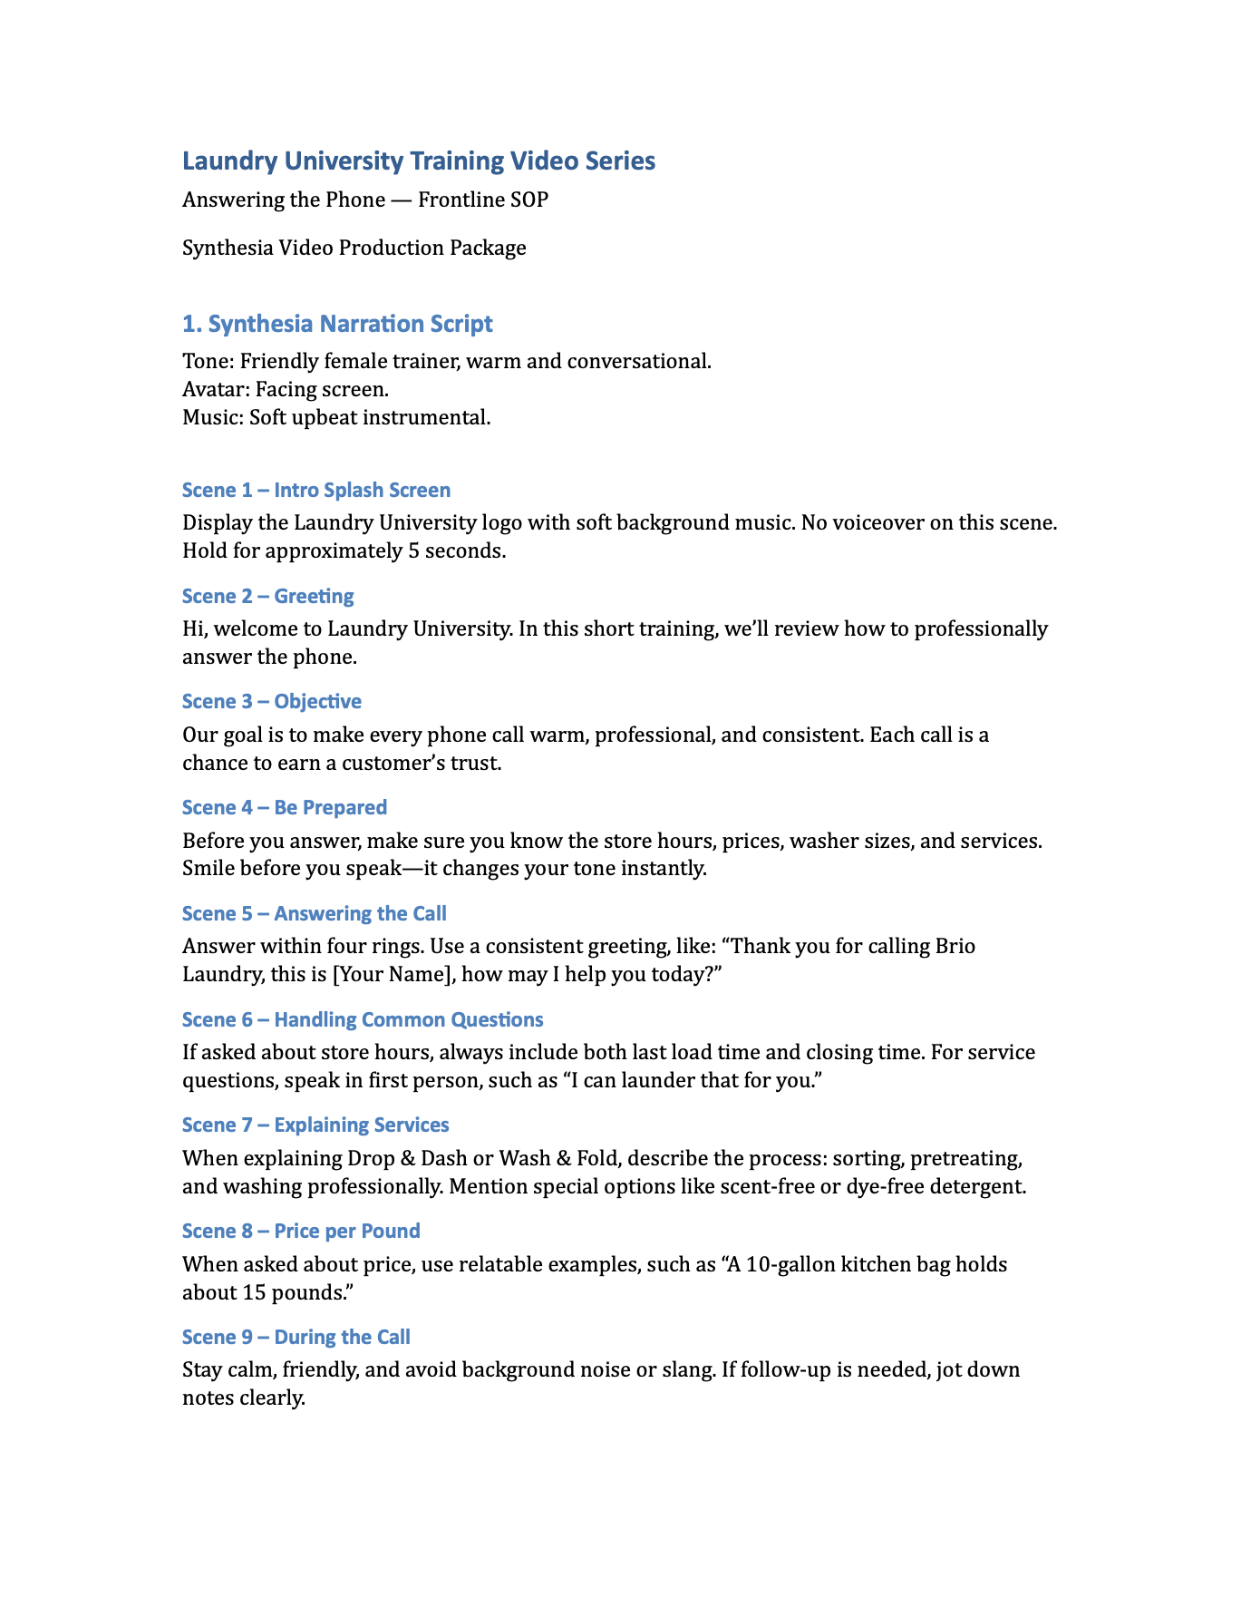

Format #4: Video
1. Start with your Document in ChatGPT
2. Input Parameters for ChatGPT: Narration Script or as Production Package
3. Use Script to Create Video (PhotoBooth, Canva or other)

Slide 37

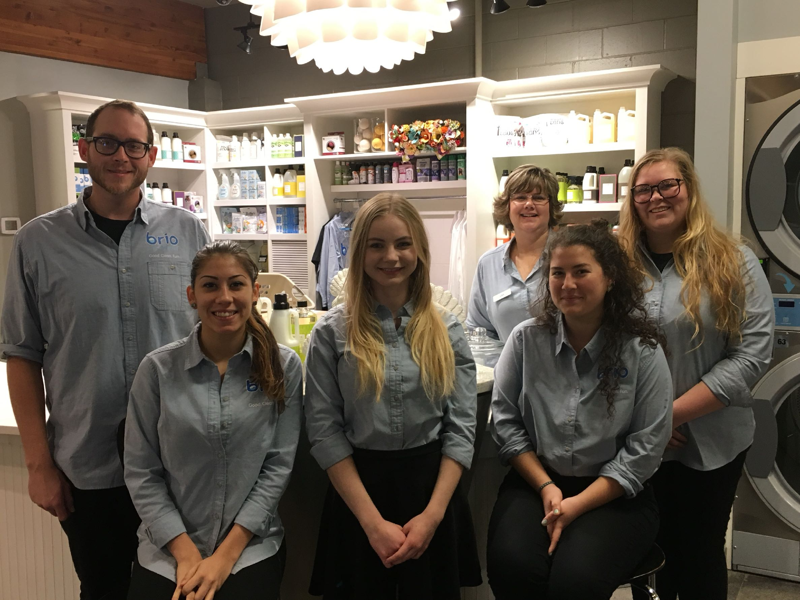
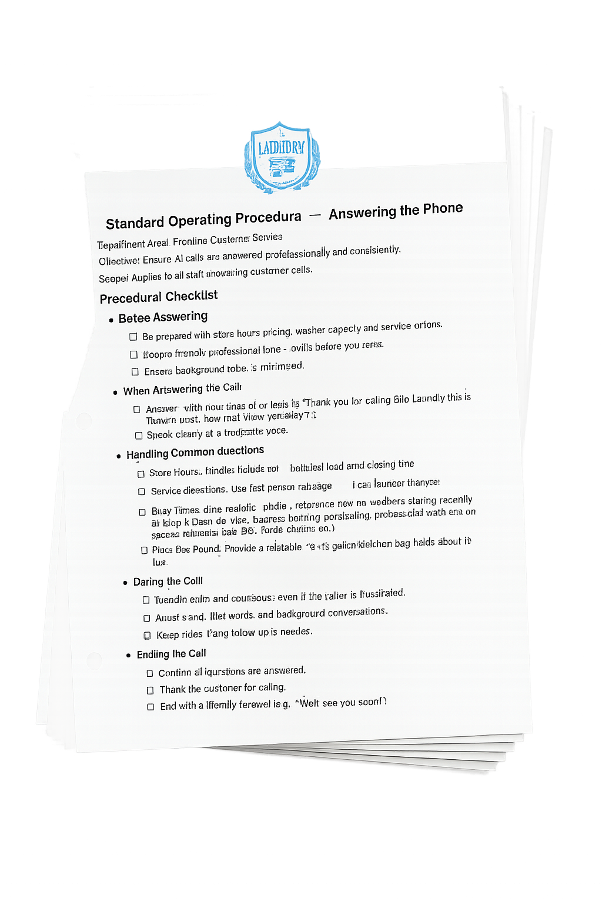

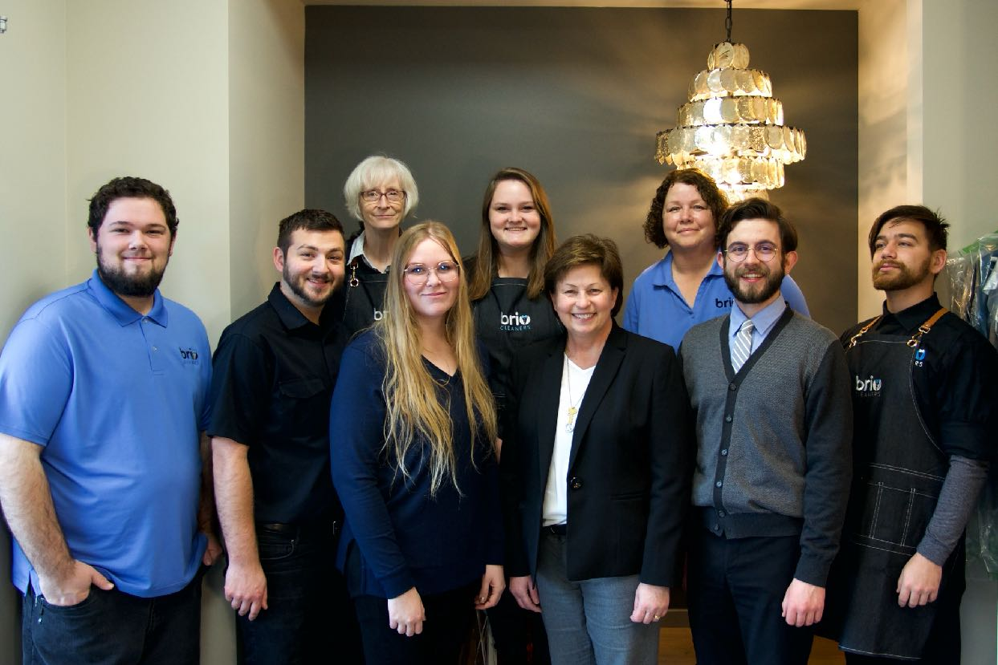
Format #3: Team Meeting
1. Download your ChatGPT Document
2. Open in Word Processor & Save
3. Print as Needed

Slide 38
SOP’s are Living Documents
POS System Computer
Payroll / Scheduling Software
Onsite Computer / Notebook
Employee Handbooks
QR codes Strategically Placed
Employee Pages of your Website

Slide 39
SOP’s create
Confident Employees

Slide 40
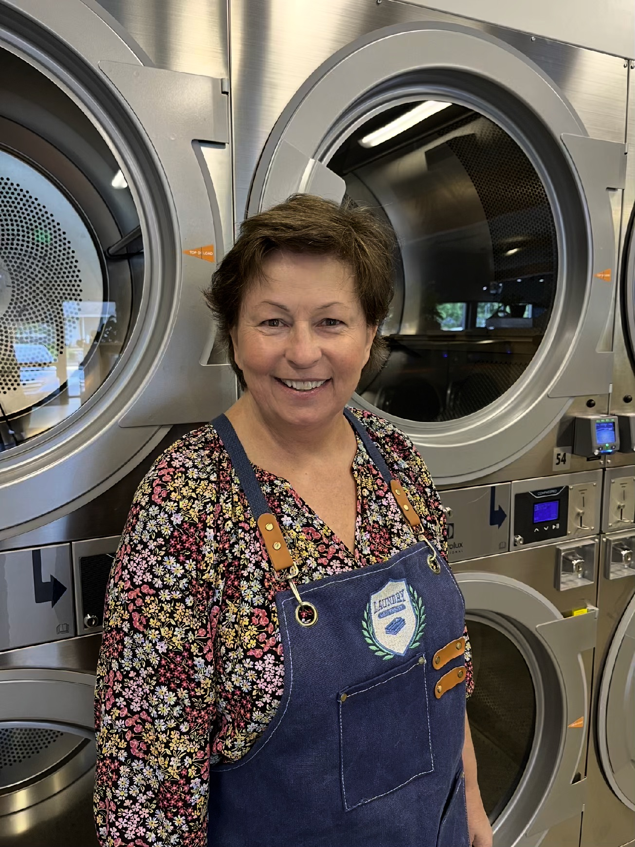
THANK YOU!
colleen@laundry-university.com

Slide 41
QUESTIONS

Slide 42

#washdryfold

