Slide 1



Fleet Management & Optimization
Carlos Ochoa - Owner
Randy Roberts - Garment Care Evangelist
Alex Dolan - CLA Insurance
r
#washdryfold
Notes:
Randy Lead

Slide 2
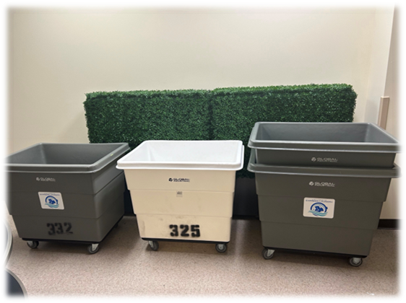
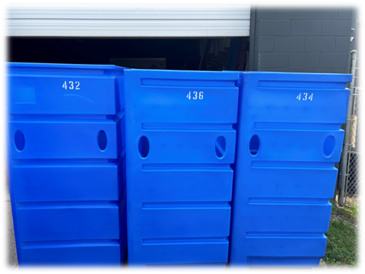
Fleet Management
1. Personnel
2. Assets – Vehicles
3. Other Assets
4. Zones
5. Route Tracking
6. GPS Tracking
r
#washdryfold

Slide 3
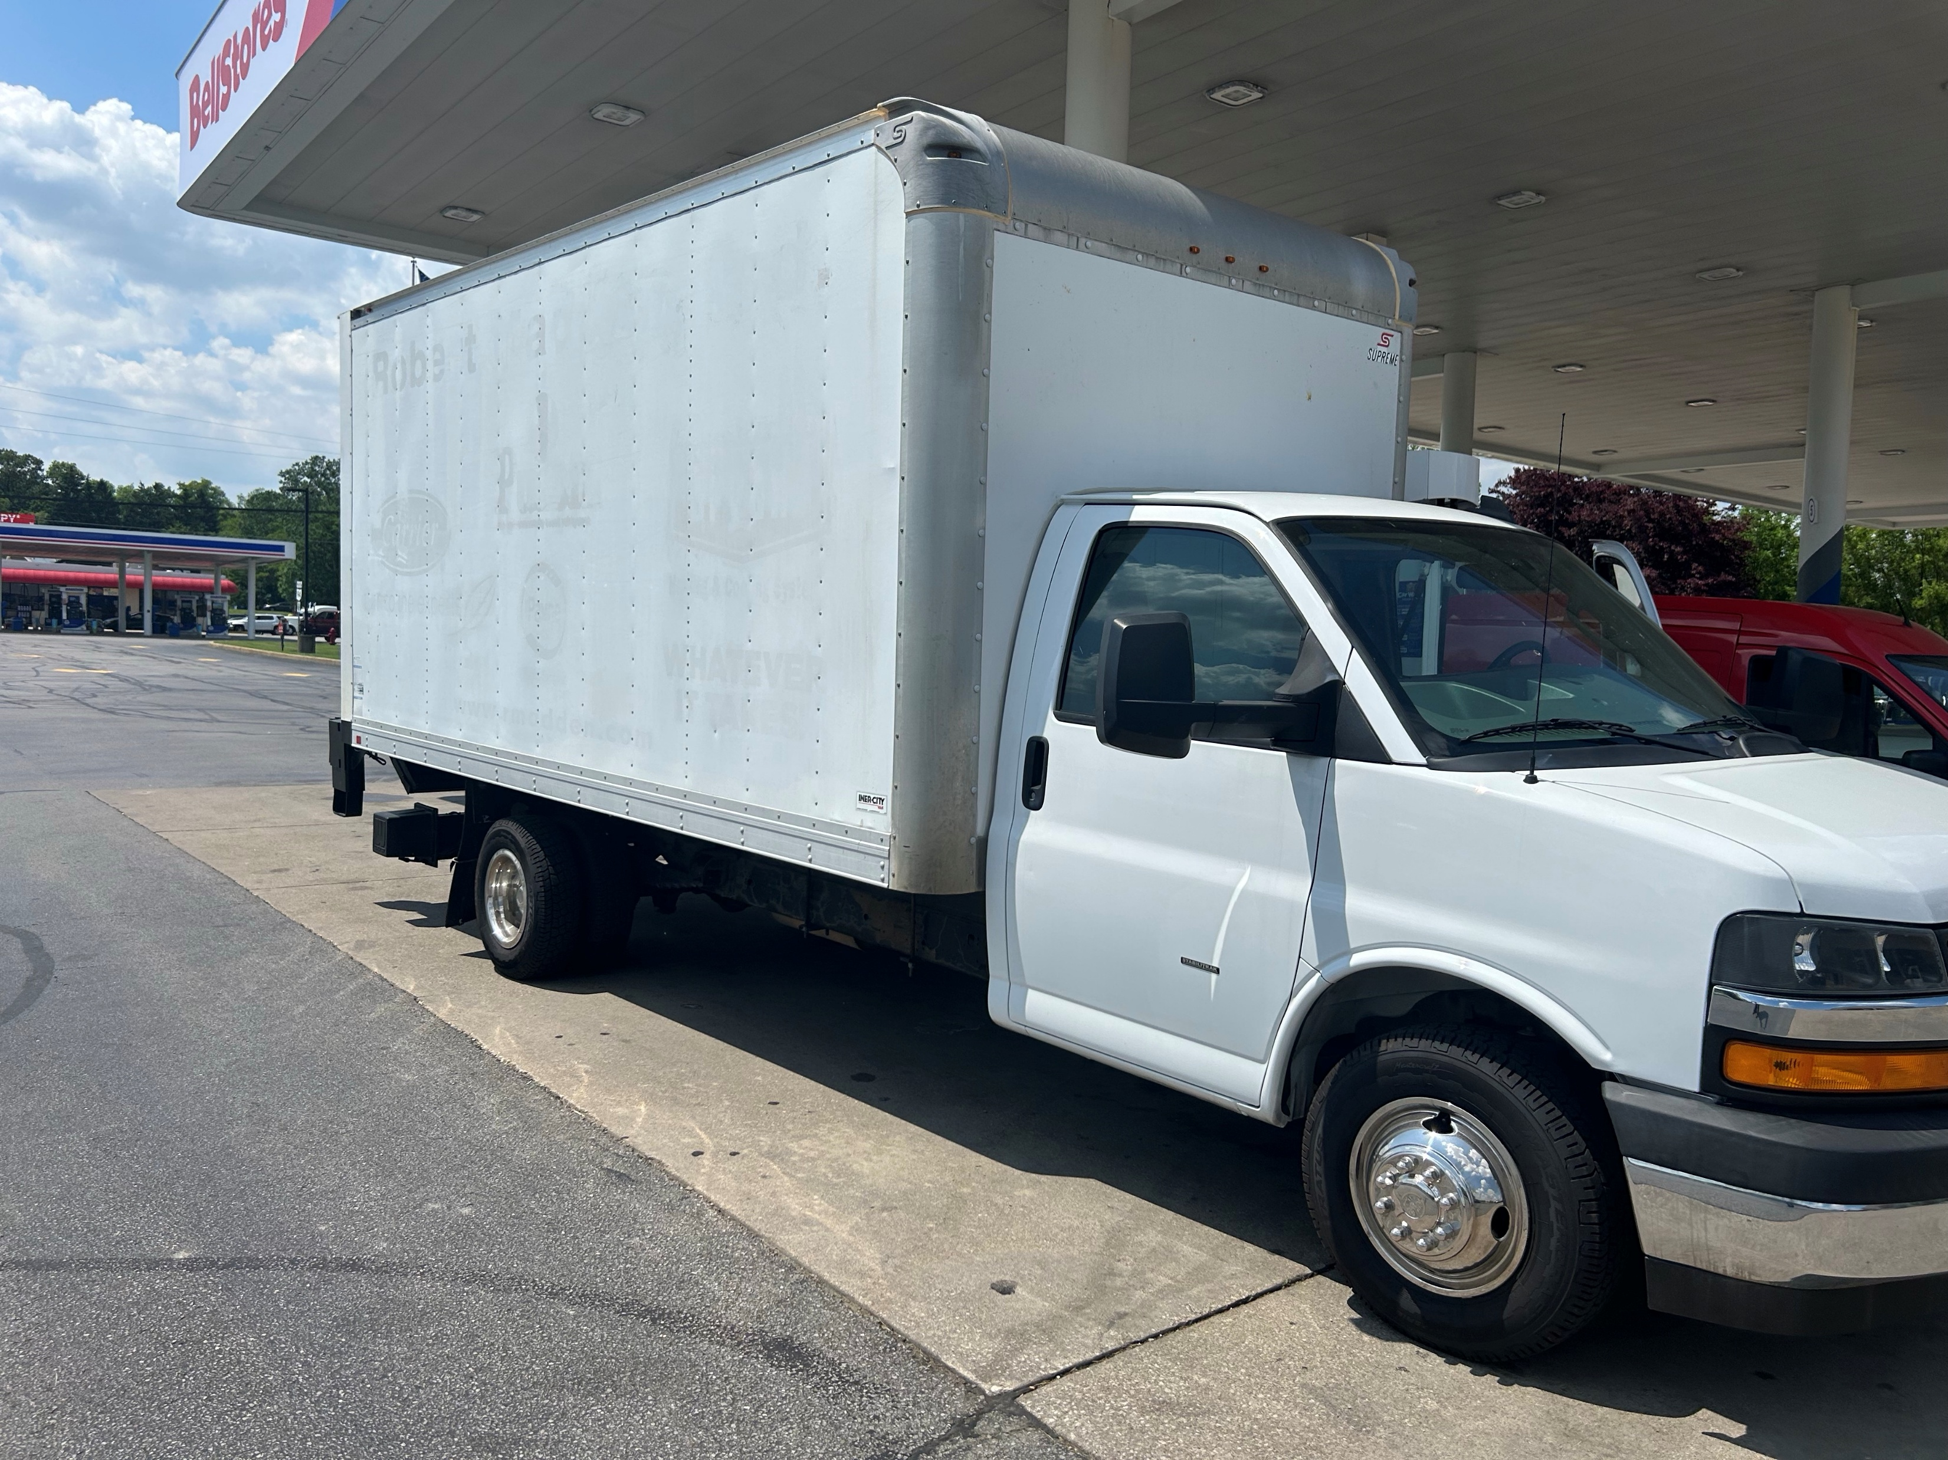
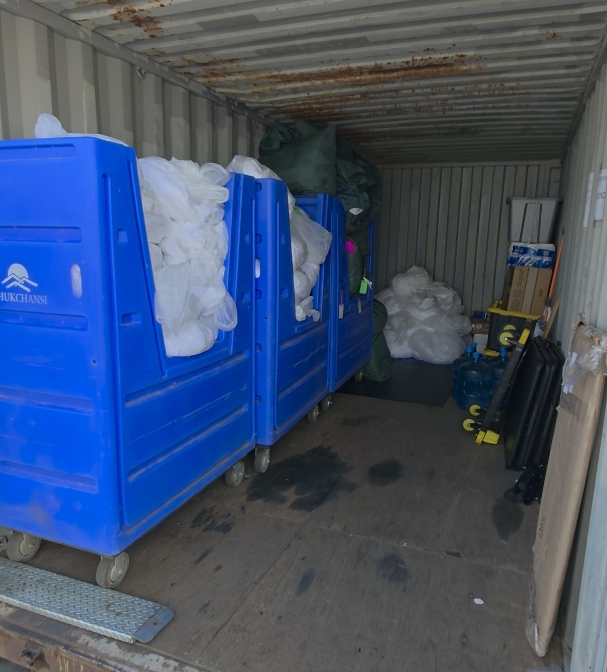
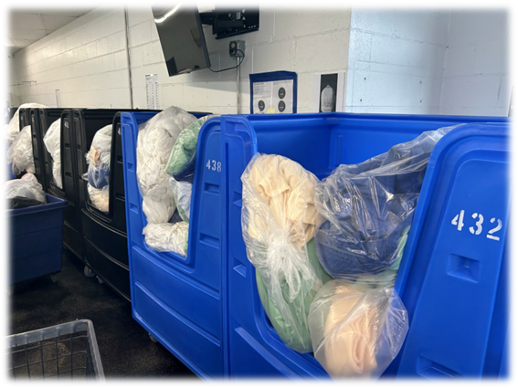
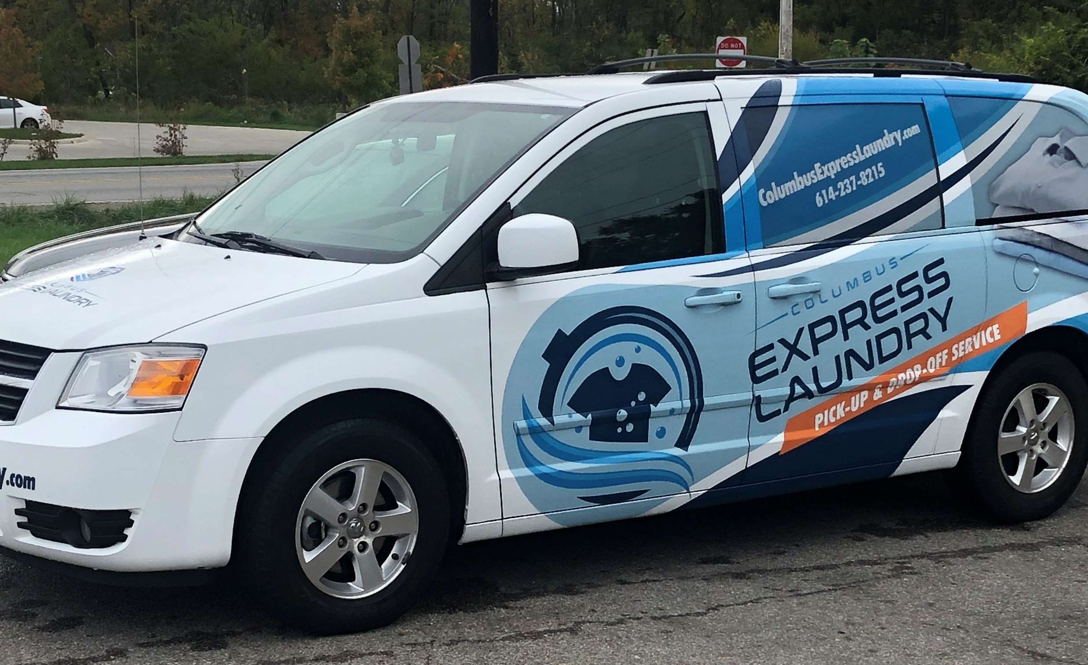
Fleet Management- Personnel
Hiring Process for Drivers
Professionalism/ Driving /Safety
Staffing- Significance of Cross-Training
c
#washdryfold
Notes:
Carlos start

Slide 4
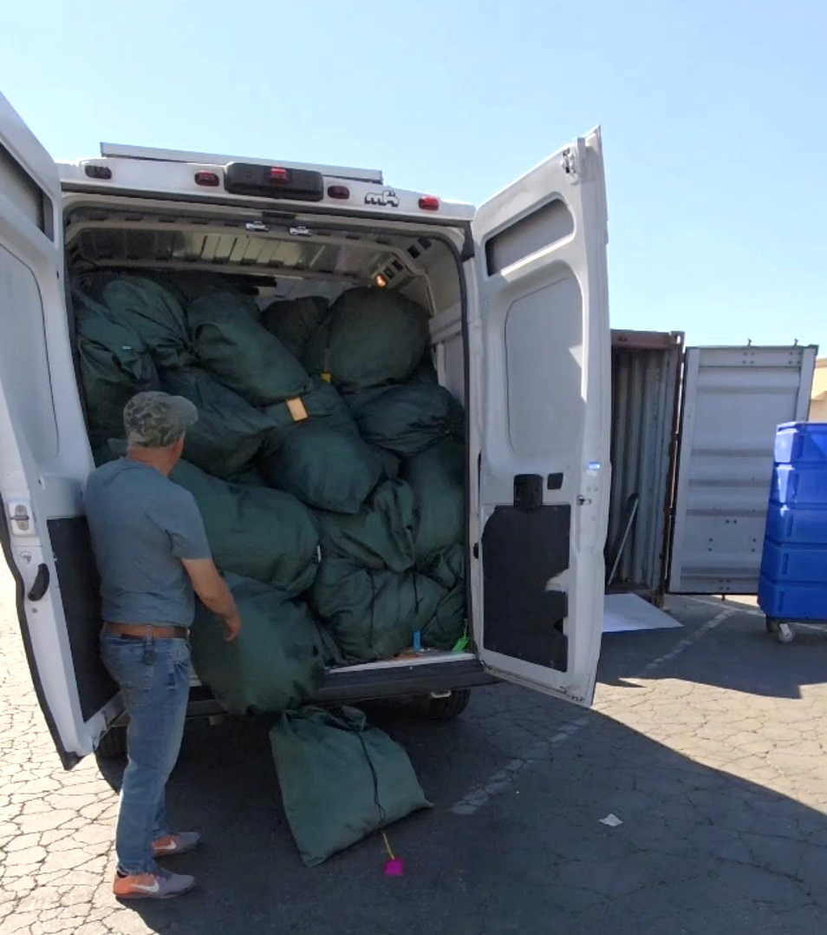
Fleet Management - Assets - Vehicles
Vehicle Selection Process
Wraps
Maintenance
Routes and Route-Optimization
Vehicle Tracking
Gig – Pickup and Delivery
When is it time to get a new one or upgrade?
r
#washdryfold

Slide 5
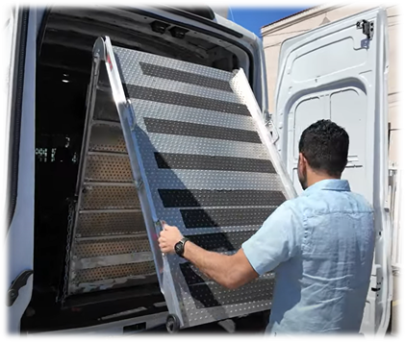
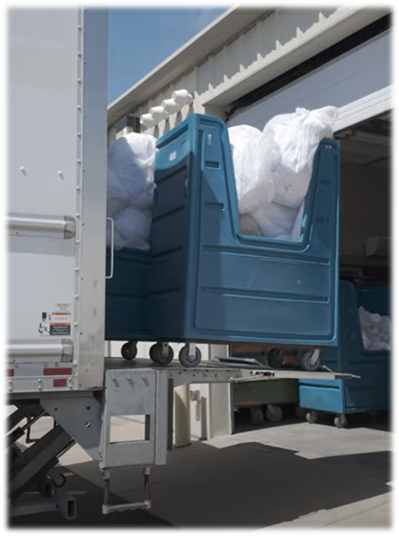
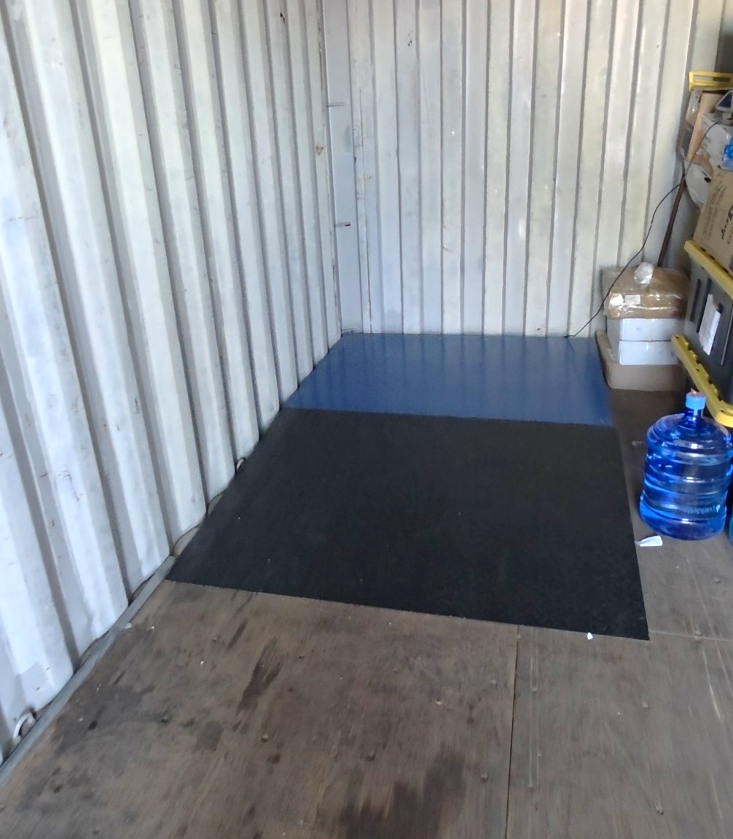
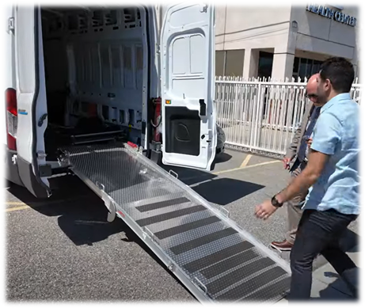
Fleet Management- Other Assets
Carting impacts on Transportation
Ramps / Liftgates
Box Truck Specifics
Significance of Slope
Additional Scales
POS/ Tablet
r
#washdryfold
Notes:
Ramps are an easy step for getting into cargo vans and sprinters
Liftgates
Dock requirements – under the tailgate
Non Dock use- can be behind the truck door
Wheel guards

Slide 6
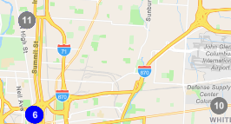
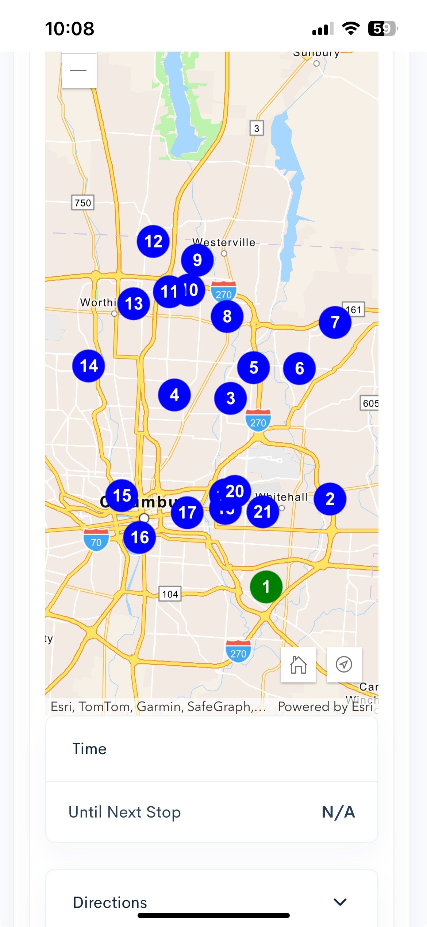
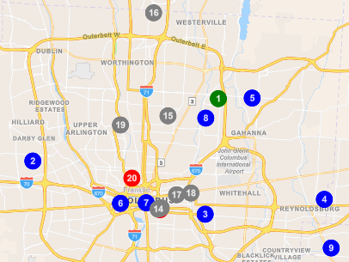
Software Route Tracking Software
c
#washdryfold
Notes:
Keys to software
Automated route design
Flexibility
Multiple route options
private routes for commercial
zones for specific areas

Slide 7
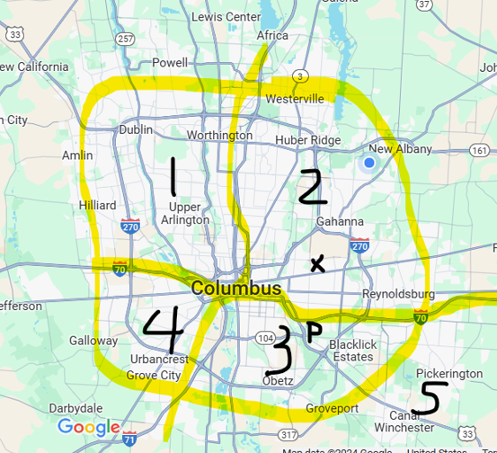
Zones
Scheduling:
  Days
  Public
  Private
Times:
  8-12 and 1-5
  8-5
  7-11 and 12-4
  Private schedules and availability
Strategies/Plans to Start:
  All
  Few
  Most
  Private
r
#washdryfold
Notes:
Keys to software
Automated route design
Flexibility
Multiple route options
private routes for commercial
zones for specific areas

Slide 8
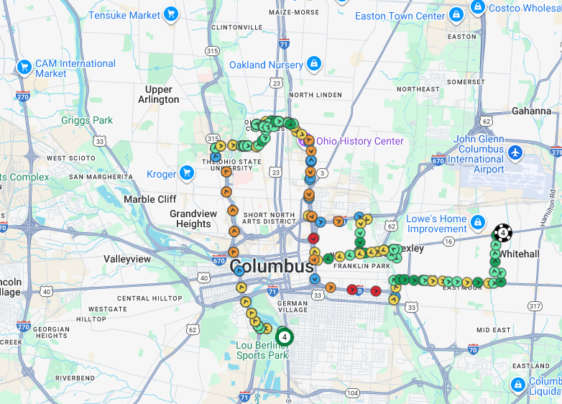
GPS Route Tracking Software
r
#washdryfold

Slide 9



Risk Management & Auto Insurance Insights for Laundromats
Alex Dolan
Account Executive
CLA Insurance
#washdryfold

Slide 10
What is Commercial Auto Insurance?
Covers vehicles used for business operations, not personal use
Protects the business from accidents, property damage, and injury claims
Includes liability, physical damage, and optional add-ons
Required if vehicles are owned, leased, or used for business purposes
Essential for laundromats with pickup, delivery, or supply
#washdryfold

Slide 11
Coverage Options
Liability Coverage: bodily injury & property damage $1,000,000 Limits
Physical Damage: collision & comprehensive
Medical Payments & Uninsured Motorist
Cargo Coverage
Rental Reimbursement / Downtime
#washdryfold

Slide 12
Hired & Non-Owned Auto (HNOA) Insurance
Covers liability of employee use of personal or rented vehicles
Can be added via endorsement to a business owners or General Liability policy $1,000,000 limit
Applies when no company-owned vehicles
Designed for occasional, incidental use — not day-to-day delivery operations
Dependent on employee compliance (valid license, insurance, safe vehicle)
Typically included on commercial auto policies
#washdryfold

Slide 13

Pros & Cons of HNOA Coverage
Pros:
Cost-effective option if the business doesn’t own vehicles
Extends liability protection to employee or rented vehicles
Often easy to add as an endorsement to a general liability policy
Provides some peace of mind for occasional errands or temporary use
Satisfies minimal insurance requirements for certain contracts
Cons:
Does not cover physical damage to employee or rented vehicles
Only covers liability — no protection for your own losses or downtime
No control over vehicle condition or maintenance of personal cars
Coverage may be denied if employees lack proper personal insurance
Claims are harder to process, as both personal and business insurers may dispute who pays
Can create false confidence — owners assume they’re fully covered when they’re not
Not scalable — becomes risky and inefficient as your delivery service grows
Usually excludes regular delivery use, which laundromats rely on
#washdryfold

Slide 14
Risk Management & Best Practices
Screen and train drivers
Check MVRs regularly
Safe driving policy
Require proof of insurance
Maintain vehicles
Use GPS or telematics
#washdryfold

Slide 15
Cost Factors & Underwriting Considerations
Driving history & claims
Vehicle type & use radius
Safety program & loss history
Location
#washdryfold

Slide 16
Key Takeaways
Protect Your Business – Commercial auto insurance covers business vehicles and employees.
Know Your Coverage – Liability, physical damage, and endorsements matter.
Leverage Telematics – Track vehicles, improve safety, and optimize routes.
Use Data Wisely – Telematics can reduce claims and lower premiums.
Prevent Before You Pay – Proactive monitoring beats reactive claims every time.
#washdryfold

