Slide 1

#washdryfold
OCTOBER 2025

Slide 2

Expenses New PUD Operators Overlook
Steve Brinks
Co-Owner and Moral Support for
The Laundry Station (Wichita KS)
#washdryfold

Slide 3

Starting a laundry PUD business sounds like a clean idea
Then you realize the hidden costs are piling up faster than dirty socks.
Get a look into sneaky expenses new PUD operators overlook when deciding to offer pick-up and delivery. Whether you're launching a new service or refining an existing one, this session can help you thrive in the pickup and delivery marketspace or at least stay afloat until you make it.
So, join us to make sure you won't get hung out to dry!
#washdryfold

Slide 4
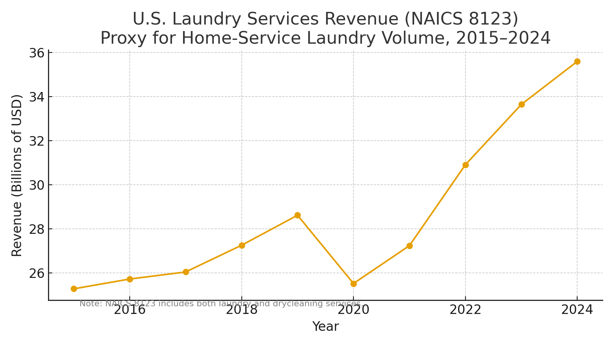
Introduction
Growing demand for convenience-driven laundry services.
Pickup & delivery as an income source.
Overlooked and underestimated expenses can add up fast.
#washdryfold

Slide 5
Overlooked Expenses
Route inefficiency & dead miles
Consumable supply overuse
Software, payment fees
Vehicle insurance & maintenance
Labor inefficiency
Missed pickups, refunds, and chargebacks
Marketing & customer acquisition lag
#washdryfold

Slide 6
Overlooked Expenses #1
Route inefficiency & dead miles:
Driver travels empty between pickups
Customers cancel last minute after route is planned
Delivery addresses far apart due to low route density
#washdryfold

Slide 7
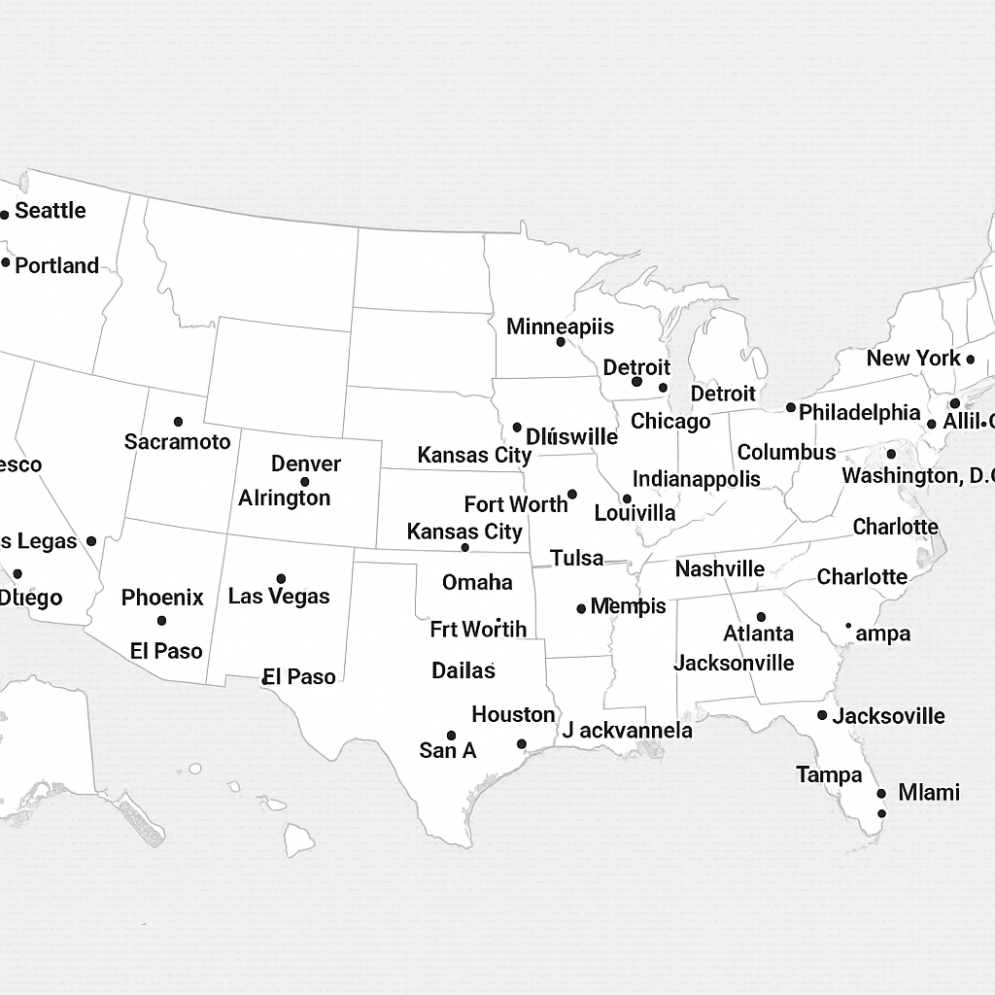
Large Route
#washdryfold

Slide 8

Compact Route
#washdryfold

Slide 9
Overlooked Expenses #2
Consumable supply overuse:
Double-bagging heavy orders
Excessive detergent use or wasted softener
Branded packaging used for every small order
#washdryfold

Slide 10

Overlooked Expenses #3
Software, scheduling, and payment fees:
Route optimization apps with per-order fees
SMS notifications billed per message
Credit card processing fees on every transaction
#washdryfold

Slide 11
Overlooked Expenses #4
Vehicle insurance & maintenance:
Unexpected repairs from delivery wear
More oil changes and tire wear (Mileage racks up quick.)
Commercial auto premiums higher than personal use
#washdryfold

Slide 12
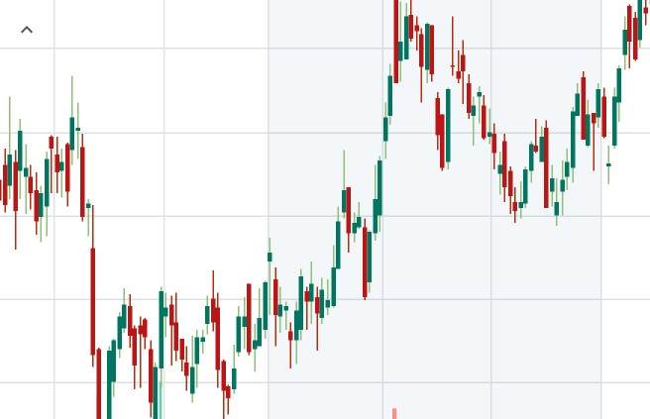
Overlooked Expenses #5
Labor inefficiency:
Waiting for dryers to finish before folding
Inconsistent workflow (No two days are ever alike)
Overstaffing/understaffing (it’s a science)
#washdryfold

Slide 13
UPs and Downs of Laundry
#washdryfold

Slide 14
Overlooked Expenses #6
Missed pickups, refunds, and chargebacks:
Customer forgets to leave laundry out
Disputed item (lost or damaged items)
Extra trip required for redelivery
#washdryfold

Slide 15
Overlooked Expenses #7
Marketing & customer acquisition lag:
Paid ads driving single orders only (65-75%)
Mail marketing to low-response areas
Early giveaways without long-term retention
Website
#washdryfold

Slide 16
Are you charging enough?
That’s a topic for another session.
#washdryfold

Slide 17


CLA Resources
These and many more white paper guides developed by experts in the industry are available to MEMBERS of the CLA.
#washdryfold

Slide 18

QUESTIONS

Slide 19
THANK YOU!

