Slide 1






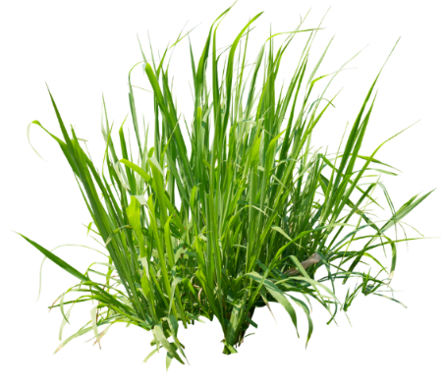
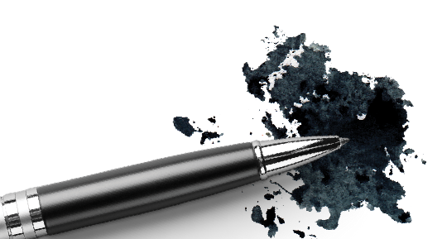
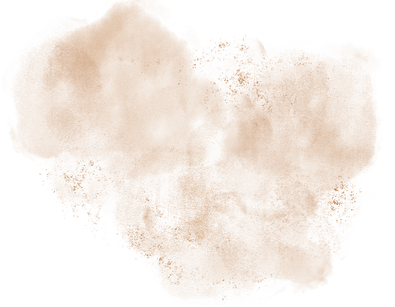

Stain Science 101
How to Outsmart the Toughest Stains
Mauricio Garduno
R&D Manager
ahprofessional.com
#washdryfold

Slide 2


The Importance of Stain Science
WDF Reality: High volume, unknown soil types, fast turnaround.
The Problem: Every re-wash is a labor and chemical cost (2x the water, 2x the energy).
The Business Value of Chemistry
Reduced Rework: Correct stain identification and treatment on the first attempt saves time and resources.
Informed Purchasing: Knowing which chemical components (like enzymes or oxidizers) are needed for stain removal, guides product selection.
Client Confidence: Providing superior stain removal expertise enhances customer satisfaction and loyalty.
#washdryfold

Slide 3
Four Pillars of Laundry Cleaning
Chemistry (Detergent/Spot Treatment): The right product for the stain type, dissolves or breaks down soils.
Temperature: Heat accelerates chemical reactions (enzymes, surfactants).
Time: Contact time allows chemistry to work and fibers to swell.
Mechanical Action: Agitation (the friction of the washer) physically loosens, breaks up and disperses the soil.
Chemistry
Temperature
Mechanical Action
Time
#washdryfold

Slide 4
Why is Chemistry the most critical variable in WDF?
You must master all four to succeed. Reducing one means compensating with another.
Chemistry handles stains that time/temperature/agitation can’t.
It allows you to use less time and energy.
Stains are complex organic (and sometimes inorganic) molecules. To clean them, you must understand their molecular properties.
We classify them into
four main groups:
Oxidizable
Protein
Oil/Grease
Particulate
#washdryfold

Slide 5

Stain Chemistry
#washdryfold

Slide 6
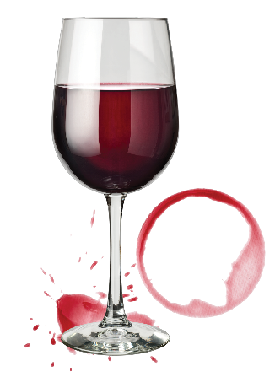
Oxidizable Stains
What Are They?
Oxidizable stains are typically brightly colored organic molecules. Oxidizable stains get
their color from a molecular structure called a chromophore.
This system absorbs and reflects light in the visible spectrum, which is what we perceive as color.
The goal of stain removal is to break this conjugated system to make the molecule colorless.
This is achieved through Oxidation.
Category | Examples
Beverages | Coffee, Tea, Red Wine, Fruit/Grape Juice
Condiments | Strong dyes in Curry, Ketchup, or Tomato Sauce
Natural | Berry Stains, Grass (Chlorophyll)

Slide 7
Primary Removal Agents:
Oxidizers or Bleaches
Cleaning Agent | Chemistry | Key Advantages | Warnings
Oxygen Bleach | Sodium Percarbonate or Hydrogen Peroxide | Color-Safe, Fabric-Friendly (Safe on most colors, synthetics, and natural fibers). Releases oxygen when mixed with water. | Works best in warm/hot water for full activation.
Chlorine Bleach | Sodium Hypochlorite | Most Effective & Fastest on tough bleachable stains. | WHITES ONLY. Extremely harsh on colors, wool, silk, and many synthetics (spandex).

Slide 8
Oxidizers/Bleaches: Other Considerations
Consideration | Action / Rule | Rationale
Heat | NEVER use hot water or a dryer until the stain is 100% gone. | Heat permanently sets the stain by chemically bonding the chromophore to the fiber.
Speed | Pre-treat or soak the stain immediately upon discovery. | The fresh stain's bond to the fabric is weaker and easier to oxidize.
Mixing Chemicals | DO NOT mix chlorine bleach with ammonia or acids (like vinegar). | Produces highly toxic and dangerous gases (chloramine gas).
Application | Always pre-treat by applying the oxidizer directly to the stain or soaking in a concentrated solution. | Increases the concentration of the active agent exactly where it is needed to break the chromophore.
Fabric Safety | Check the care label and always test the oxidizer on a hidden seam first. | Some dyes and fabric types (like wool and silk) can be damaged by strong oxidizers.

Slide 9
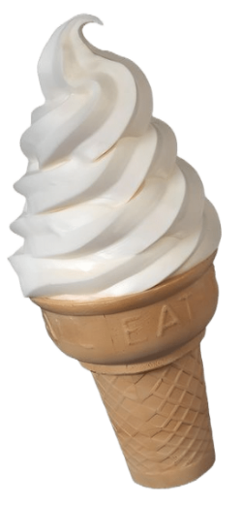

Protein Stains
What Are They?
Protein stains are biological in nature, consisting of large, complex, organic protein molecules (polymers).
Proteins are generally insoluble in water.
The key chemical problem with these stains is their susceptibility to Coagulation (or Denaturing).
The removal strategy, therefore, must focus on breaking these large molecules without using heat.
Category | Examples
Bodily Fluids | Blood, Sweat, Urine, Vomit
Food & Dairy | Milk, Baby Formula, Egg, Meat Juices, Ice Cream
Plant/Natural | Grass (contains Chlorophyll and Protein)

Slide 10
Primary Removal Agents: Enzymes
    Protein stains are removed via Enzymatic Breakdown , a targeted chemical reaction that digests the large protein chains.
Cleaning Agent | Chemistry | Action | Critical Application
Enzymes | Biological catalysts found in enzymatic stain removers and detergents. | They break the peptide bonds (hydrolyze) in the protein chains, yielding smaller, water-soluble peptides that wash away easily. | The only effective method for set or dried protein stains.

Slide 11
Enzymes: Other Considerations
Consideration | Action / Rule | Rationale
Temperature | AVOID HEAT. Use COLD water for pre-treatment and soaking. | Heat causes protein denaturing/coagulation, setting the stain permanently (making it insoluble).
Soaking Time | Pre-treat and allow the enzymatic solution to soak for 30 minutes up to several hours. | Enzymes are slow-acting catalysts; they require time to fully "digest" the large protein molecules.
Fabric Safety | Avoid strong enzymatic cleaners on Wool and Silk. | These fabrics are also protein-based and can be damaged or dissolved by aggressive enzymes.
Combination Stains | If a stain has an oil component (e.g., milk, greasy meat), pre-treat (surfactant) before using the enzyme. | Lipase enzymes (for oil/fat) or strong surfactants must break the fatty part first to allow the protease access to the protein core.
Drying Check | Always air dry the garment after washing. Do not use the machine dryer unless the stain is completely gone. | Air drying allows you to confirm the stain's removal without the risk of permanently setting any remaining residue.

Slide 12


Oil & Grease Stains
What Are They?
These are stains composed of fats (lipids), oils (triglycerides), and hydrocarbons.
Chemistry: Oil/grease molecules are non-polar. (No distinct positive or negative ends in the chemical)
The Problem: Laundry water is polar. As the rule "like dissolves like" suggests, water and oil naturally repel each other.
The non-polar oil molecules lock deep into the non-polar pockets of the fabric fibers, creating a strong bond that simple water and agitation cannot break or dissolve.
Category | Examples
Cooking | Butter, Olive Oil, Salad Dressing, Grease, Peanut Butter
Cosmetic | Lipstick, Foundation, Body Oil, Heavy Creams
Industrial | Motor Oil, Tar, Automotive Grease

Slide 13
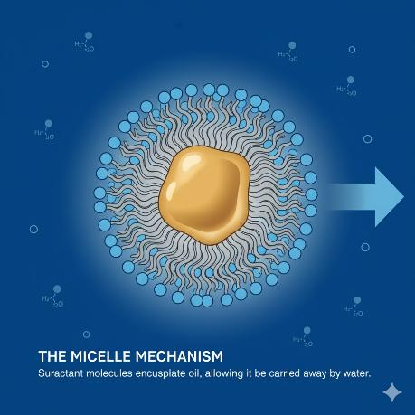
Primary Removal Agents: Oil & Grease Stains
Surfactant molecules are the fundamental tools for cleaning non-polar (oil/grease)
stains because they are amphiphilic: they have a dual affinity.
Hydrophilic Head: (Water-loving) This part is polar and interacts with the wash water.
Hydrophobic Tail: (Water-fearing / Oil-loving) This part is non-polar and interacts with the oil stain.
The Micelle Mechanism (Emulsification)
When added to water, surfactants aggregate around oil droplets to form micelles.
Penetration: The hydrophobic tails bury themselves deep into the non-polar oil/grease stain.
Encapsulation: The tails surround the oil droplet.
Suspension: The hydrophilic heads face outward, allowing the micelle (now containing the oil)
to be suspended in the water and rinsed away. The oil is effectively is dissolved in water.

Slide 14
Particulate & Inorganic Stains
What Are They?
These stains are solid, insoluble matter that is primarily mineral or elemental in composition. They are physically trapped within the fibers of the fabric.
The Problem (Physical): Mud and dirt particles are mechanically held within the woven structure of the fabric, requiring high mechanical energy (agitation) to dislodge.
The Problem (Chemical): Some particles (especially Clay, Mud, and metallic stains) are held to the fabric by ionic bridging with hard water minerals (Calcium or Magnesium).
Removal requires a combination of three actions: Mechanical Force, Chelation, and Dispersion.
Category | Examples | Key Characteristic
Common | Soil, Mud, Clay, Dust, Sand, Soot/Carbon | Physically trapped (insoluble)
Metallic/Rust | Iron/Rust (Fe), Hard Water Scale (Calcium/Magnesium) | Chemically bound (often by ionic charge)
Pigments | Some colored pigments (e.g., from paint, permanent ink) | Highly stable and mechanically lodged

Slide 15
Primary Removal Agents: Particulate & Inorganic Stains
Agent Type | Chemical Function | Action in Water | Target Stains
Builders / Chelators | Complexing agents (e.g., EDTA, Citrates, Zeolites). | Neutralizes Ionic Bridges - They tightly bind to and sequester metal ions Ca, Mg, Fe that cause water hardness and link soil to fabric. | Hard Water Stains, Clay, General Soil
Dispersants | Special polymers and certain nonionic surfactants. | Suspension - They coat the dislodged soil particles, giving them a strong negative charge, which forces them to repel each other and the fabric, keeping them suspended in the wash water. | All Particulates, Soot, Carbon Black
Acids | Mild organic acids (e.g., Oxalic or Citric Acid). | Reduction - Changes the chemical state of rust to a water-soluble form that can be rinsed away. | Rust and Iron Stains ONLY

Slide 16

Pro Tips: Particulate & Inorganic Stains
Dry Before Treatment: For heavy mud or clay, allow the stain to dry completely. Brushing or scraping the excess dry matter off first significantly reduces the load on the chemical agents.
Agitation is Key: Since particles are physically trapped, use the highest agitation setting safe for the fabric, and pre-scrub the stained area with a soft brush to physically loosen the bonds.
The Rust Rule: NEVER apply chlorine bleach to rust or iron stains. Bleach is an oxidizer and will chemically worsen the rust, permanently setting the orange color. Use only acid-based rust removers.
Post-Wash Check: Always inspect the garment before drying. If any grayish residue remains, it means the dispersants failed to suspend all the soil. Repeat the pre-treatment and wash cycle (with extra builder/detergent) before applying heat.

Slide 17
Stain Classification: Overview
Stain Type | Common Examples | Molecular Challenge | Primary Removal Chemistry
Oxidizable / Color | Red Wine, Tea, Coffee, Fruit Juice, Permanent Marker Ink. | Chromophore Destruction: Highly colored organic molecules (chromophores) absorb light, making them visible. | Oxidation: Use Bleaching Agents (Sodium Hypochlorite or Hydrogen Peroxide) to break the double bonds in the chromophore, rendering it colorless.
Protein / Enzymatic | Blood, Grass, Egg, Milk/Dairy, Bodily Fluids (Sweat, Vomit). | Coagulation by Heat: Large protein chains denature and physically bond to fibers, becoming "cooked" and insoluble if exposed to hot water. | Enzymatic Digestion: Use Protease Enzymes to catalyze the breakdown of long protein chains into smaller, water-soluble peptides and amino acids.
Oily / Greasy | Cooking Oil, Butter, Lipstick, Motor Grease, Body Sebum. | Hydrophobic Repulsion: Non-polar fat/oil molecules repel water (polar solvent), preventing simple rinsing or dissolving. | Emulsification: Use Surfactants (Anionic or Nonionic) to form micelles around the oil, making the non-polar grease soluble and suspendable in water.
Particulate / Inorganic | Mud, Clay, Dirt, Rust (Iron), Hard Water Scale. | Insolubility & Ionic Bridging: Solid mineral particles are insoluble and often stick to fabric fibers via metal ions acting as a "bridge." | Chelation & Dispersion: Use Builders/Chelators to sequester bridging ions, freeing the particles. Use Dispersants to suspend the particles, preventing redeposition.

Slide 18
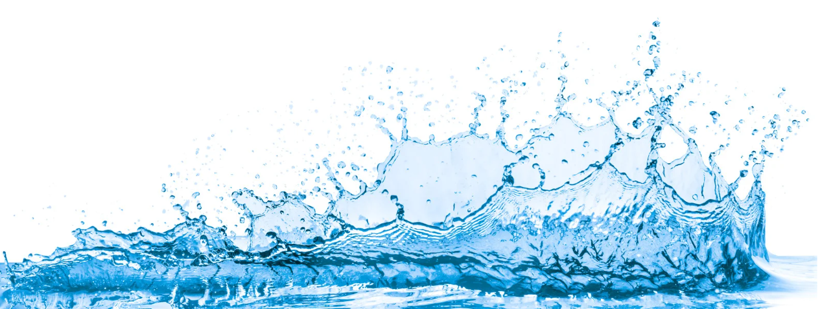
Water Chemistry
#washdryfold

Slide 19
Water Quality: The Hidden Cost Factor
The Problem: Water Hardness
Water quality in laundry is primarily defined by hardness, caused by dissolved mineral ions (especially Calcium) and Magnesium.
Effect on Detergency:
  Hardness ions react with anionic surfactants (soaps/detergents) to form insoluble precipitates (soap scum).
  This consumes the active detergent, dramatically reducing cleaning efficiency.
Water Quality Area of Impact | Impact
Fabrics | Causes stiffness, graying, and yellowing (dullness). Can lead to premature wear.
Equipment | Scale formation (limescale) on heating elements, pipes, and drums, reducing heat transfer efficiency and machine lifespan.
Cleaning | Requires significantly higher dosages of detergent to achieve the same cleaning results.

Slide 20
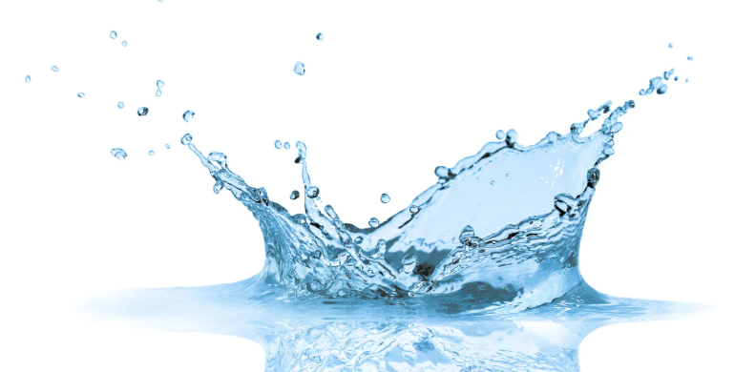
Builders and Chelants—The Water Treatment Toolkit
Builders (Alkalinity Support)
Function: Primary role is to maintain an optimal high pH environment (alkalinity) for cleaning, and to provide initial mineral sequestration and soil suspension.
Mechanism:
  pH Buffer: Keeps the wash water alkaline, which aids in breaking down fats and oils and enhances (builds) surfactant performance.
  Minor Chelation: Binds a portion of Ca and Mg ions.
  Dispersing Agents: Helps prevent redeposited soil from settling back onto the fabric.

Slide 21
Types of Builders
Builder Type | Key Function
Sodium Carbonate (Soda Ash) | Strong Alkalinity & Precipitation ability. Highly effective pH booster; precipitates hardness.
Sodium Bicarbonate (Baking Soda) | Mild Alkalinity & Buffering. Baking soda is a core chemical component known for boosting detergent performance by adjusting pH (mild alkalinity), deodorizing, and softening water. This natural chemical boost enhances cleaning.
Zeolites | Ion Exchange. Binds Ca (but not Mg as well) by exchanging it with Na. Used mainly in powder detergents.
Silicates | Corrosion Inhibition. Protects machine parts, especially aluminum, and provides some alkalinity.

Slide 22
Chelants—The Water Treatment Toolkit
Chelants (Sequestering Agents)
Function: Specialized agents used to inactivate metal ions, ensuring water is "soft" regardless of initial hardness level. Essential for heavy-duty cleaning and stain removal.
Mechanism:
  Strong Binding: Forms a stable, soluble, non-reactive ring-like structure around metal ions (Ca, Mg, Fe)
  Full Inactivation: By sequestering these ions, they cannot interfere with surfactants, react with bleach
  (which causes fiber damage), or precipitate to form scale/scum.
  Examples: EDTA (Ethylenediaminetetraacetic acid), DTPA (Diethylenetriaminepentaacetic acid),
  various specialty polymers.

Slide 23

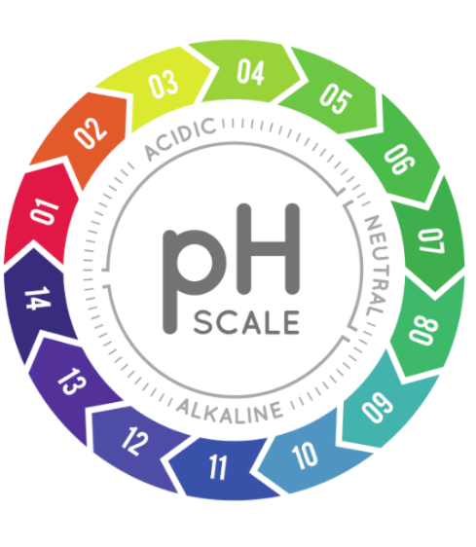
pH and Temperature
#washdryfold

Slide 24
The Role of pH in Stain Removal
Definition:
pH is the measure of acidity/alkalinity. Laundry Zones: Most cleaning happens in the alkaline zone (pH≈ 9−11).
pH Spectrum in Laundry
Neutral (7-8): Suitable for delicate items; provides gentler cleaning.
Alkaline (8.5-11): The standard range for most heavy-duty cleaning. High pH is the foundation of powerful stain removal.
Acidic (< 7): Used primarily for specialty applications like rust or mineral scale removal.
Why Alkalinity is Crucial (High pH)
Saponification & Soil Breakup: High pH hydrolyzes (breaks down) fatty soils (grease, oils) into water-soluble soaps (saponification), making them easy to lift.
Surfactant Efficiency: Most anionic and non-ionic surfactants exhibit optimal cleaning performance and solubility in alkaline conditions.
Builder Activation: Builders are designed to dissolve and function optimally in this range, providing the necessary water conditioning.
Enzyme Performance
Detergent enzymes (Lipases, Proteases, Amylases) are engineered to have peak activity within the specific pH range of the detergent formula (usually slightly alkaline, 8-10). A stable pH buffer is vital for their sustained function.
Specialized Acidic Cleaning
Acidic cleaners (pH 2-4) are rarely used in the main wash, but are essential for removing mineral scale, hard water deposits, or rust stains (iron oxide) from fabrics or equipment, as these require acidic dissolution.

Slide 25
The Role of pH in Stain Removal
Stain Chemistry and pH
Acidic Stains: Coffee, tea, fruit juice, grass. These stains are often best solubilized and lifted at higher (pH 9-11) levels.
Alkaline/Protein Stains: Blood, milk, eggs, bodily fluids. These stains require high pH to open up the protein structure, allowing proteases (enzymes) to break them down.
pH Control of Bleaching Agents
Oxygen Bleach (Peroxide/Percarbonate): Requires Alkaline conditions (pH 9-11) to be activated. The high pH drives the formation of active perhydroxyl ions (HOO-), the actual cleaning agent.
Chlorine Bleach (Sodium Hypochlorite): The active sanitizing and bleaching agent is Hypochlorous Acid (HOCl).
Optimal Use (pH 11+): Keep in a highly alkaline state (Hypochlorite Ion (OCl-) to prevent the release of toxic chlorine gas.
Danger: Mixing with strong acids (low pH) releases hazardous chlorine gas.

Slide 26
Temperature Strategy: Hot vs. Cold
Enzyme Activity Window
Optimal Range: Detergent enzymes (Proteases, Lipases, etc.) are highly sensitive to temperature.
They exhibit peak activity in the warm-to-hot range (generally 30°C to 60°C or 86°F to 140°F).
Denaturation Risk: Temperatures above the optimal range (e.g., boiling water) can cause enzymes to denature (change structure), rendering them permanently inactive.
Bleach Activation and Sanitization
Oxygen Bleach (e.g., Sodium Percarbonate): Requires elevated temperatures (60°C or 140°F) for optimal activation, where the resulting peracetic acid or hydrogen peroxide species are most reactive.
Sanitization: High temperatures (>60°C) are necessary to achieve effective thermal sanitization and kill bacteria and mites, even without chemical sanitizers.
The Cold Water Trade-Off
Modern Formulations: Cold-water detergents use specialized, low-foaming surfactants and cold-adapted enzymes to work efficiently at 15°C (60°F) or lower.
Limitations: Cold water is less effective against heavy grease, oils, and certain protein/starch combinations compared to warmer washes, making pre-treatment or specialized agents necessary.

Slide 27
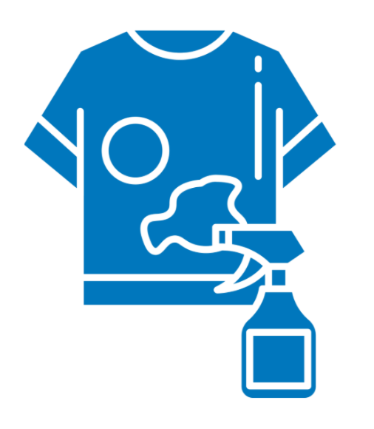
Pre-Treatment
#washdryfold

Slide 28
The Power of Pre-Treatment (Spotting)
What is Pre-treatment?
Applying a specialized, high-concentration cleaning agent directly to a stain before the main wash cycle.
This is also known as "spotting" in professional settings.
Goal: To break the chemical bond between the stain and the fabric fiber while the stain is still localized.
The Chemical Advantage
Concentration is Key: The pre-treatment formula is applied undiluted or highly concentrated, overwhelming the stain with surfactants, solvents, and enzymes.
Time: Pre-treating grants the necessary soak time (e.g., 5-30 minutes) for enzymes and solvents to work. Time is essential for enzymatic hydrolysis —breaking large, insoluble molecules (proteins, starches, fats) into smaller, water-soluble pieces.
Targeted Solvent Action: Specific stains (e.g., ink, oil, paint) often require organic solvents (e.g., alcohols, glycol ethers) that are not present in the main wash detergent. Pre-treatment allows for precise solvent application.
Prevent Set In Stains
Stains, especially blood, protein, and tannin-based ones, can be chemically set (fixed)
permanently by heat or strong alkalinity.
Pre-treating allows the use of appropriate cold or pH-neutral agents to dissolve the
stain before the garment enters a hot, alkaline main wash.

Slide 29
Benefits of Pre-Treatment (Spotting)
Reduction of Re-Wash
The Cost of Failure: In a laundromat or commercial facility, a garment that requires rewashing due to a missed stain
incurs costs in labor, water, energy, and chemicals for a second cycle.
High First-Pass Success: Effective pretreatment maximizes the chance of achieving a clean garment in the first wash, dramatically lowering the overall rewash rate and associated operating expenses.
Optimizing Machine Utilization (Throughput)
Faster Turnaround: By minimizing rewashes, machines (washers and dryers) spend less time processing the same items, freeing them up for the next load. This increases the total throughput of the business.
Controlled Chemical Usage
Precision Dosing: Spotting uses minimal amounts of highly specific chemicals exactly where they are needed, reducing the need to excessively "overdose" the entire main wash bath with expensive agents to compensate for localized heavy stains.
Fabric Preservation: Successful pre-treatment ensures the main wash cycle can be less aggressive (e.g., lower temperature or shorter cycle), which extends the lifespan of the textiles—a critical factor for linen rentals or uniform services.
Quality and Customer Satisfaction
Brand Reputation: Delivering spotlessly clean items consistently builds customer trust and reduces complaints, which is essential for any laundry business.

Slide 30
Key Takeaways & Impact to Business
Key Concept | Takeaway | Business Impact
Stain Classification | Stains are molecules (proteins, oils, dyes, minerals, etc). Each type of stain requires specific chemicals to unlock and remove them from fibers. | Incorrect identification leads to wasted chemicals, longer cycles, and set stains, leading to costly re-washes and dissatisfied customers.
Water Chemistry | "Hard" water contains dissolved minerals. These minerals react with detergents, making them less effective and leave behind residue. | Ignoring hard water leads to dull whites, excessive detergent use, equipment scaling, and reduced cleaning power, increasing operational costs.
Understanding pH and Temperature | Temperature and pH are chemical catalysts: Most cleaning happens in Alkaline conditions (pH 9-11). Enzymes are active at warm temps, but denature if too hot. Surfactants & Oxidizers (oxygen bleach) become more active at higher temperatures. Proteins set permanently with initial hot water contact. | Using the wrong pH/temperature wastes chemicals and energy, damages fabrics, and sets stains. Optimizing these factors maximizes chemical efficiency and stain removal.
Pre-Treatment | Applying a concentrated cleaning agent directly to a dry stain before the main wash cycle can decrease time and chemicals needed in the main cycle. | This targeted approach breaks down tough stains before they enter the general wash, significantly reducing the likelihood of re-washes and may help preserve fabric.

Slide 31

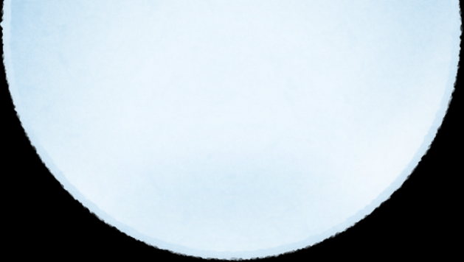


QUESTIONS

Slide 32
THANK YOU!

