Slide 2
WDF vs Retail
How to set up your laundry for both WDF & Retail customers

Slide 3
Introduction
Travis Unema
Brio Laundry (Bellingham WA)
County population 230,000 people
4,500 sq ft store with 95 machines
Open 7 days a week
Fully attended
Services offered: WDF, PUD, self service, dry cleaning

Slide 4
Instructions
1 smart watch per person
Please wait to scan QR codes until prompted!

Slide 5
Goals for today
Learn how to set up WDF in a retail store
Learn what data to collect
Identify the Key Performance Indicators (KPI) to monitor
Identify helpful steps to scale WDF around self-service retail customers

Slide 6
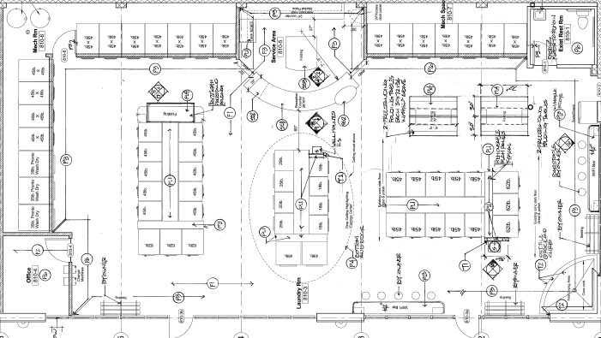
Starting Layout

Slide 7
Round #1

Slide 8
Round #1 Goal: Increase WDF
What I added to increase WDF:
Dirty & clean storage bins/shelves
Shelf/bin labeling system
Covered & locked shelves for security
Advertised for WDF/PUD (radio, social media, word of mouth, packaging advertising, email campaigns)
Attendants on shift launder the WDF orders

Slide 9
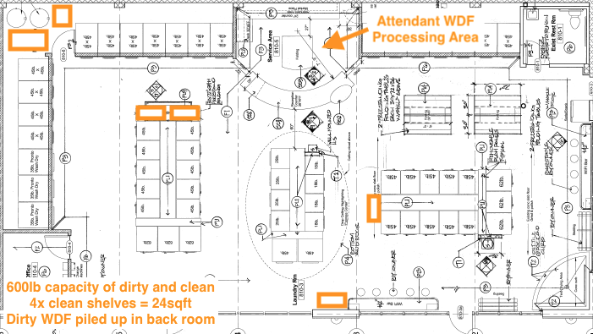
Starting Layout
Clean orders: shelves
Holds 45lbs a shelf
540 lbs clean capacity
Dirty orders: 3 collapsible rolling bins
3’x2’ bins = 150lbs ea
450lbs dirty capacity

Slide 10
Round #1 Problems Identified
Storage:
Clean shelves displaced 2 folding tables and took up 25 sq ft of retail customer space
Customers would grab orders without going through attendant
1 order was stolen off the shelf!
COGs storage wasn’t organized (paper, tape, bags)
Retail turns going down as WDF increases
WDF was up 10%…& retail income went down by 4%
Machine usage competition between WDF orders and retail customers

Slide 11
Round #1 left me with 4 options:
I could…
Lower volume of WDF orders
Close store to Retail customers
Set up a night shift for laundry production
Design WDF procedures that allow WDF turns and Retail turns to scale at the same time.

Slide 12
Round #2

Slide 13
Round #2: Increase WDF & Retail
Setup: set up WDF rules
Health/data: figure out what I need to measure and where to get data from
Monitor KPI’s: use data to make decisions
Resources: I need to train my team for consistent production. Managers need measurable metrics for performance reviews. Improve communication efficiency between; attendants, clients, owner.

Slide 14
Time to put on your watches!
Settings
Health
KPI’s
Resources

Slide 15
Settings:
Machine Usage:
Identify busiest/slowest days of the week for retail turns
Identify slowest times of every day
Attendant Training:
Designate washers/dryers/folding for WDF orders
Designate production days/times for WDF orders
Train attendants to produce the same way
Storage
Storage labeled, secured, separate dirty & clean
Set order turnaround time
*Reducing turnaround time reduces storage requirements!

Slide 16
Settings:
Scan the blue smart watch for a step by step guide!

Slide 17
Health:
Data to collect:
Turns (washer starts): Retail & WDF
Labor: hours of attendants, drivers, cleaning shifts
1/2 WDF, 1/4 janitorial, 1/4 customer service
Orders: weight, start time, completion time, items
Machines: track attendant usage & retail usage
WDF: revenue, tax, tips, COGs
Utilities: water, sewer, gas, phone, electricity, internet

Slide 18
Health:
Scan the green watch for a detailed list of data to record

Slide 19
KPI’s
Labor hours per order
Labor cost per order
Orders completed per day
Order weight average
Order completion time
Utility cost per turn (WDF & retail turns!)
Retail turns per machine
WDF turns per machine
Profit margin per WDF order

Slide 20
KPI’s
Use the KPI’s to monitor your settings/health and ensure:
WDF & retail turns are not affecting each other. If retail machine #3 turns are down, check to see if attendants are using #3.
Efficient machine utilization: is the team putting 20lb WDF orders into at 45lb machine?
WDF lbs per hour lets you know employee efficiency
Performance tool for managers that is measurable!
Set attainable goals for team
Order completion time frame lets you set accurate turn-a-round times
Shelf time of a completed order. Call customer to have them pick up ASAP!

Slide 21
KPI’s
Scan the orange watch for a detailed list of KPI’s to monitor

Slide 22
Resources:
Don’t reinvent the washing machine!
Use each other as a resource
Fill out the form and receive:
KPI master spreadsheet
Signage for machines
Recommendation for shelves/bins
Customer service form templates
Introduction to an online attendant training program
Communication tags for washers/dryers

Slide 23
Resources:
Scan the teal watch for access to FREE resources

Slide 24
Round #2 Procedural Review:
Settings: WDF rules have been set up and implemented
Health: data collection routine set up
KPI’s: use the data to see how our settings are working
Resources: training recommendations, industry friends, FREE signage!

Slide 25
Round #2 Results
WDF & PUD (’22-’23)
orders up +17.92%
lbs per day +25.09%
lbs per order +6.08%
labor hours per order -14.35%
order average 16.86lbs
Retail self-service (’22-’23)
machine income up 14.95%

Slide 26
Other Considerations:
Production Buffers:
Re-washes (train to wash in 1)
Store disruptions (washer flood, security)
Production deals (winter storms, illness, covid, ghosted)
Damages (YOU are responsible for customer clothes
Defined plans for attendants:
What does attendant do if production is behind schedule? What are they to focus on?
What if one attendant hand picks “easy orders” over baby laundry orders?

Slide 27
Round #3

Slide 28
Round #3 Store Design:
After have success from round 2 I started planning round 3
Store Design:
Designated storage rooms
Back of house processing
Laundry lockers for customer pickup/drop off
Increase retail space (machines, folding tables, lockers, seating, open areas
November 2023 design upgrade completed!

Slide 29
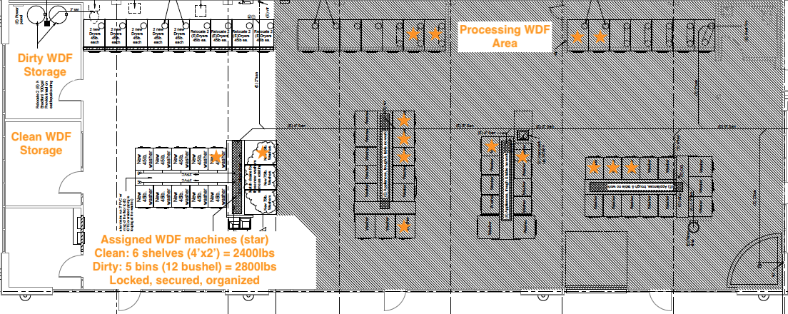
Round #3 Store Design:

Slide 30
Time to share!
Collaboration is our best strength!
Collect all 4 QR codes by finding someone with a different smart watch! Keep the conversation going!
Piece together the nuggets of info you learned today and splice them into your own version that fits your store!

