Slide 2


I’VE DECIDED TO INVEST IN A VENDED LAUNDRY.
WHAT’S NEXT?

Slide 3


DON’T RUSH!
What are your goals – 1, 3, & 10 years?
  Replace spouse’s income?
  Get out of your job?
  Diversification of investments?
  Build a legacy business?
It takes time, effort and patience to find a good opportunity
When you do, take your time and do it right

Slide 4

HOW MUCH DO YOU HAVE TO INVEST?
  30 – 40% cash investment is typically required
  Determines the size and scope of your project

Slide 5
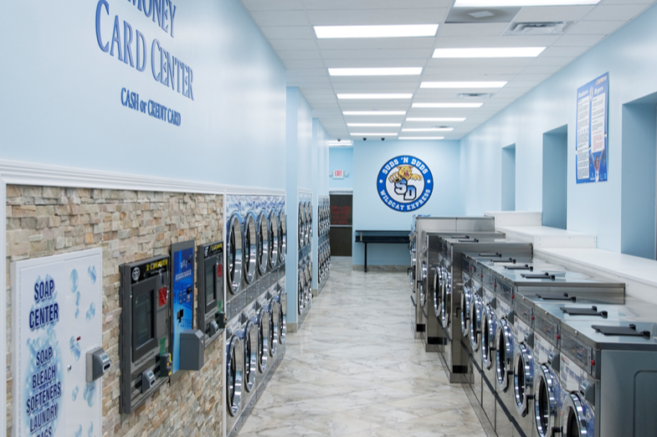
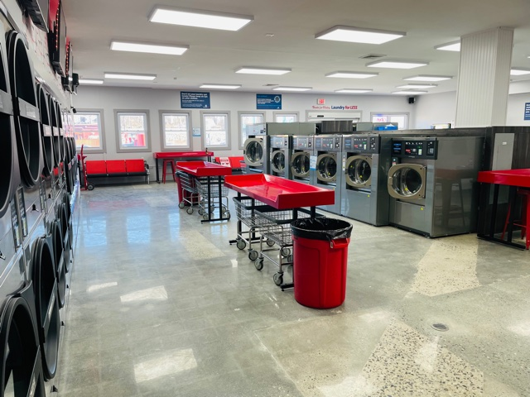
WHAT ARE YOU LOOKING FOR?
Typical Store
1,500 - 2,500 Sq. Ft.

Slide 6
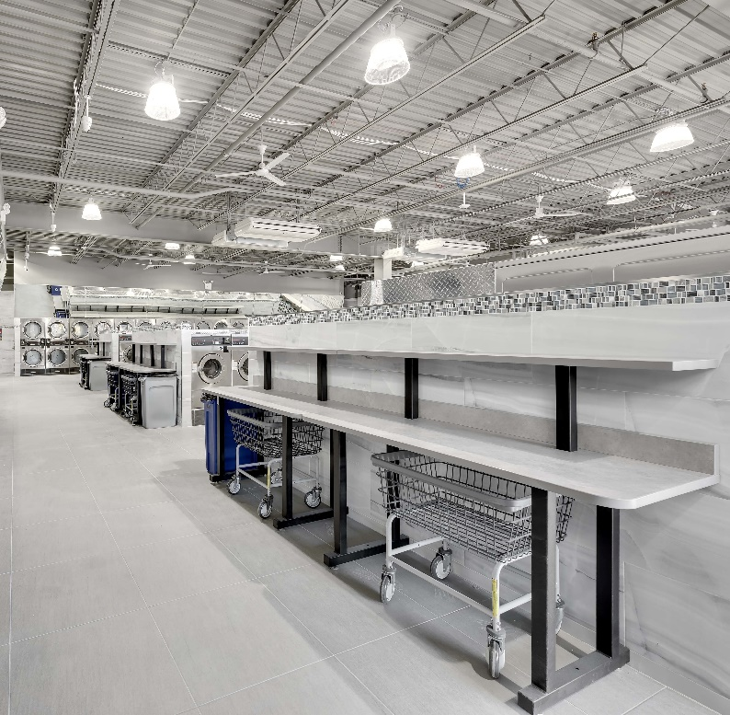
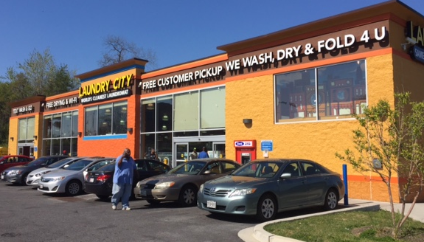
WHAT ARE YOU LOOKING FOR?
Mega Store
5,000 - 8,000 Sq. Ft.

Slide 7
KNOW THE MARKET
Demographics
  Average household income
  % of renters
  Persons per household
Interview equipment distributors
  Reputation within the industry
  What stores have they built?
  Do they have installation & service capabilities?
  Seek referrals
Know your equipment brands
  Features and benefits
  Efficiencies
Check with local building department
  Are there impact or hookup fees?
  New permits issued?
Competition in your footprint
  Machines
    Age and condition of machines?
    Stores wash & dry capacity?
    Vend prices for each machine?
  Wash-Dry-Fold
    Is it offered?
    Minimum quantities and pricing
  Bathrooms
    Are they available for use?
    Would you allow your mom/child to use this bathroom?
  Security/safety issues?
  Hours of operation?
  Good visibility?
  Can you tell the difference between attendants and customers?
  Cleanliness of stores?
Tip of the Day: Plan to do wash in all competitor stores! WHY?

Slide 8


REDUCE YOUR RISK – BUILD NEW STORE
Laundromat
  Choose a qualified distributor
  Choose a brand of equipment
  Determine methods of payment you will accept
    Coin, tokens, credit card, phone applications
  Hire a qualified general contractor
Due diligence
  Understand Utility requirements
  Pro Forma Financial Statements & Cash Flow

Slide 9
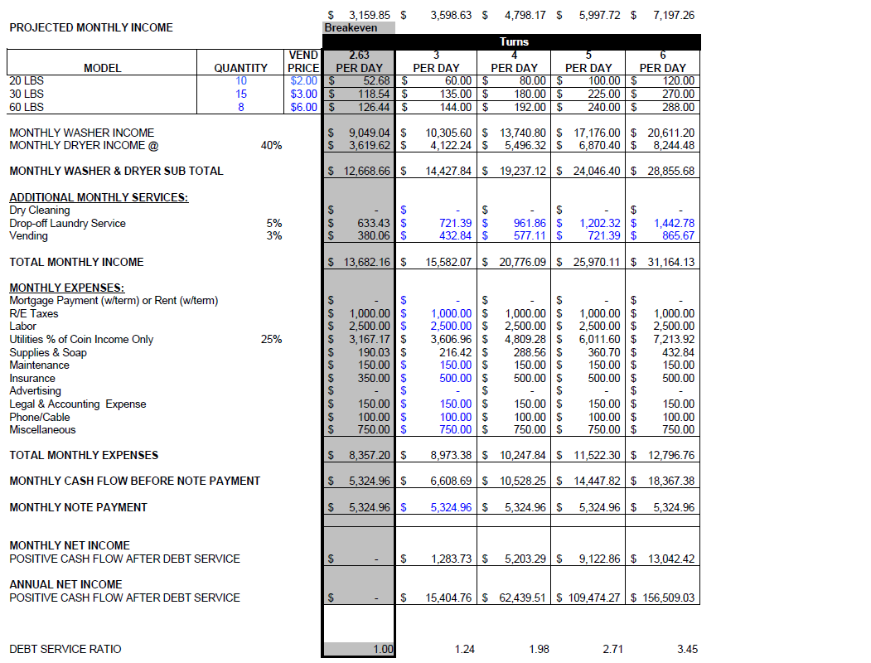
PRO FORMA CASH FLOW
(NEW STORE)
SAMPLE

Slide 10
REDUCE YOUR RISK – ACQUISITION
Laundromat Business
  Hire a competent lawyer, preferably with laundry acquisition experience
  Due diligence
    Financials/cash flow
    Utility bill analysis
    Card system and POS reports
    Equipment condition (service reports)
    Vendor list
  Know your lease!
    Must be assignable and “fundable” (base term + options)
    Good guy clause or dark clause?
    If LL sells, then lease is still intact?
  Ask others
    Distributor partners
    Experienced store owners
  Hire a qualified general contractor if remodeling is needed
Laundromat Business & Property
  Hire a competent real estate lawyer
  Determine the proper ownership experience of the property & business

Slide 11
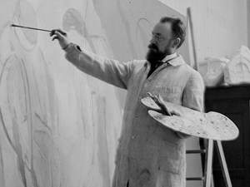


PAY THE RIGHT PRICE: VALUATION
Art vs. Science
Generally 2 to 5 times EBIDTA (annual cash flow before debt service)
Contributing factors
    Age of machines
    Lease terms
    Competition

Slide 12

WHO MAKES LOANS?
COMMODITY
BANKS / SBA
CAPTIVES
BROKERS
OTHER
INDUSTRY SPECIFIC
FAMILY
CREDIT CARDS
HELOC

Slide 13
FINDING THE BALANCE
SPEED
QUALITY
PRICE/RATE
Pick 2 – Then find the right lender for you.

Slide 14
CHECKLIST: WHAT MOST LENDERS WILL ASK FOR
All Deals:
  Signed Credit Application / Personal Financial Statement / Past 2 years personal & business tax returns
  2-3 months personal & business bank statements
  Copy of existing premises lease or deed
  Valid Photo ID (for all guarantors)
  Signed equipment invoice (If adding new equipment)
If buying an Existing Laundromat:
  Signed copy or draft of the purchase agreement
  YTD profit & loss statement
  Financial statements or tax returns from the seller
  3-6 months utility bills from the subject store (gas, water and electric)
If building a New Store:
  Signed construction contract

Slide 15
BASIC UNDERWRITING REQUIREMENTS
Personal credit scores from the 3 credit bureaus
Personal net worth – minimum of 1:1 net worth to requested loan amount
Cash Flow
  New Stores – pro forma cash flow
  Existing Stores – actual cash flow
Collateral
  New Stores – equipment purchase price, cost of leasehold improvements/construction, collateral assignment of lease
  Existing Stores –appraisal of existing equipment, collateral assignment of lease
  Additional items: real estate, other businesses, certificates of deposit
Location Analysis
  Market rents
  Competition analysis
  Demographics
  Local business developments

Slide 16

HELPFUL RESOURCES
Local Distributors
  Industry knowledge
    Store Design
    Building Codes
  Referrals to service providers
    Attorneys
    Contractors
Manufacturers
  Regional sales reps
  Equipment specs
Coin Laundry Association
  Planet Laundry magazine, Special events – webinars, networking, Clean Show
  Local chapters

Slide 17

QUESTIONS

