Slide 2

From Analysis to Action:
Driving Business Value Through Insights into Today’s Economy
April 2024
Presented by
Alex Chausovsky

Slide 3

Our Talk Today
Topics We'll Cover
  Macroeconomic Update
  Leading Indicator Input
  Labor Market Data
  Actionable Takeaways

Slide 4
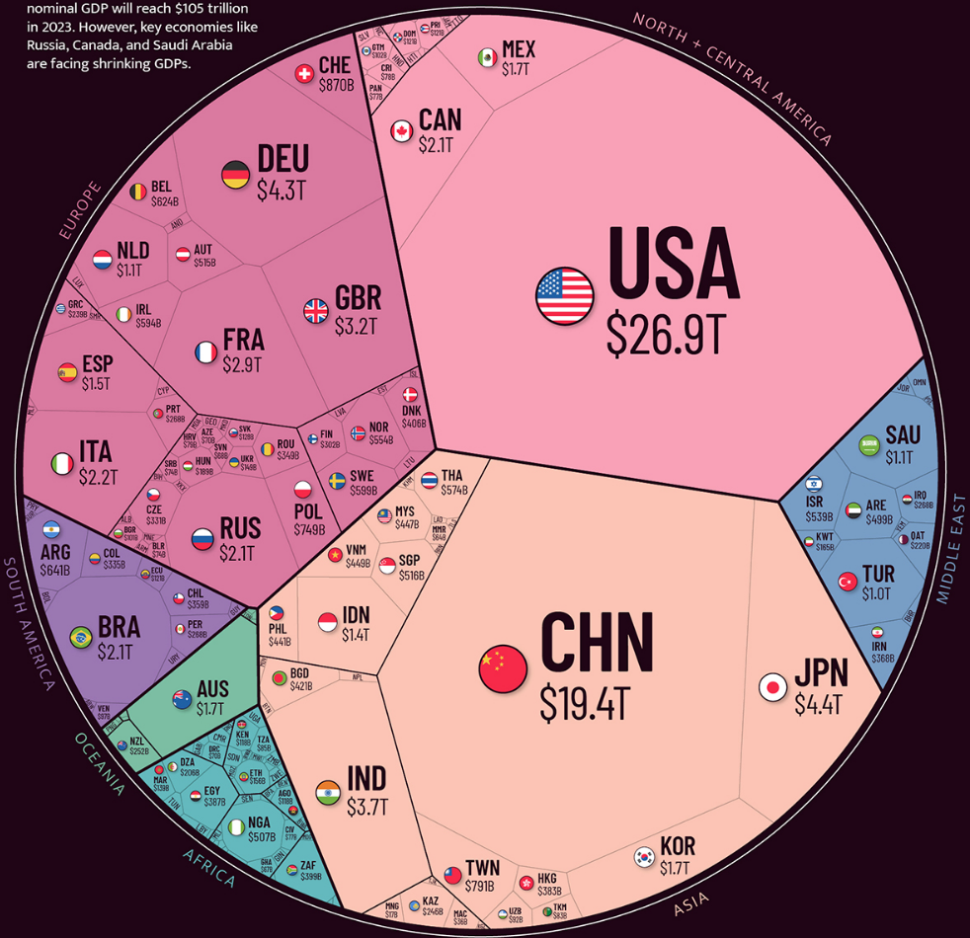
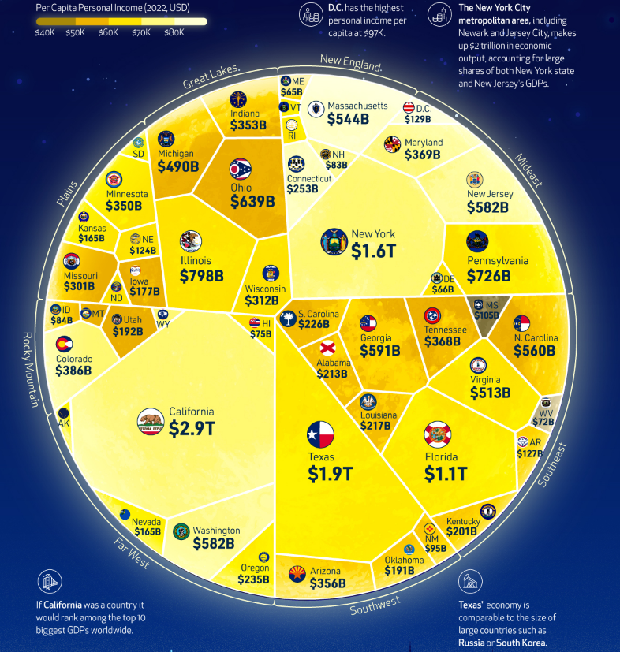
The Global and US Economies
Source: Visual Capitalist | Bundy Group
Source: Visual Capitalist
Notes:
Inflation | Sharply Rising Interest Rates | Supply Chain Issues | War

Slide 5
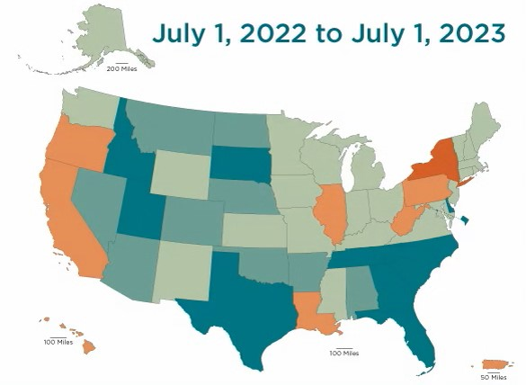
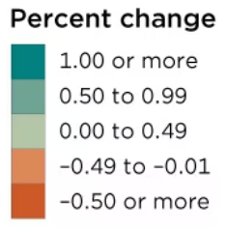
Percent Change in State Population
Source: US Census Bureau| Bundy Group

Slide 6
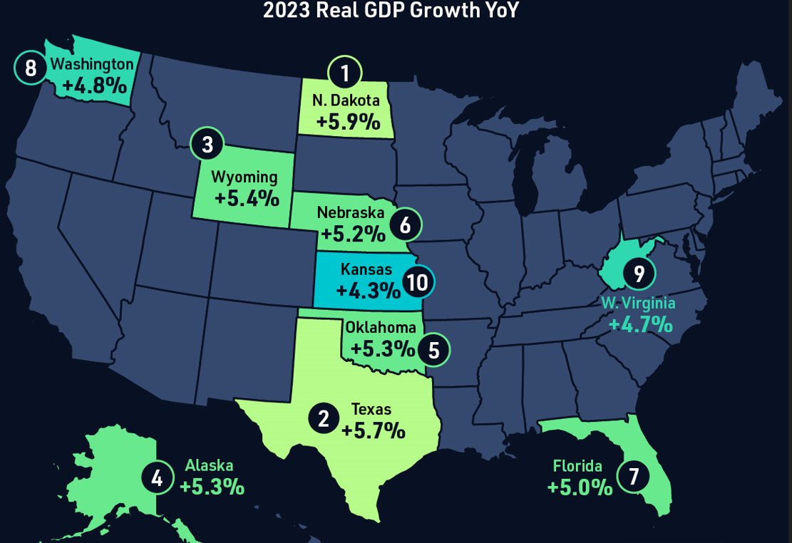
US Growth Hotspots in 2023
Source: Bureau of Economic Analysis | Visual Capitalist | Bundy Group

Slide 7
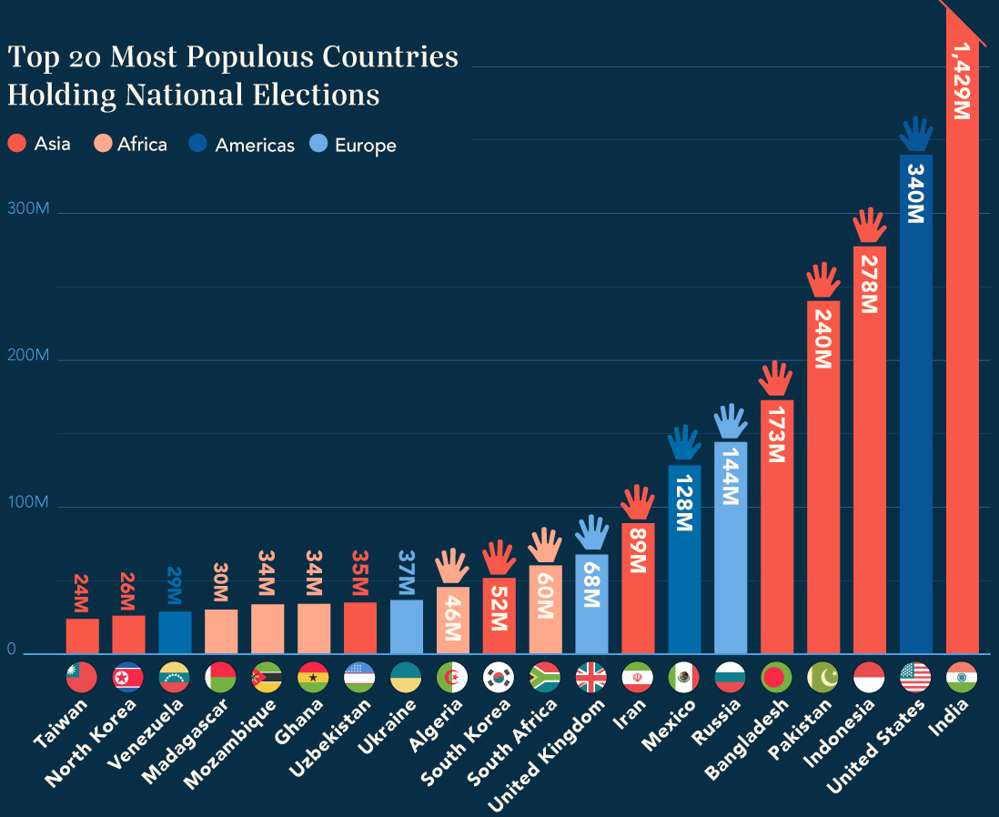
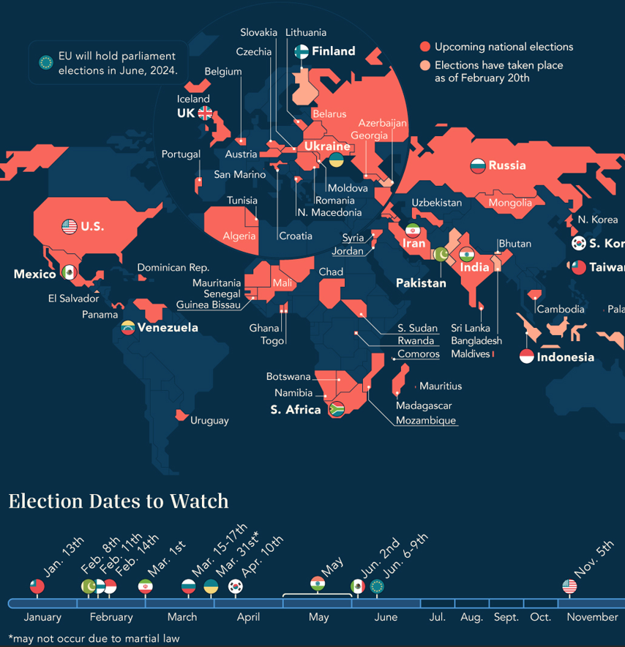
2024 is the Year of Global Elections
Source: Visual Capitalist | Ballotpedia

Slide 8
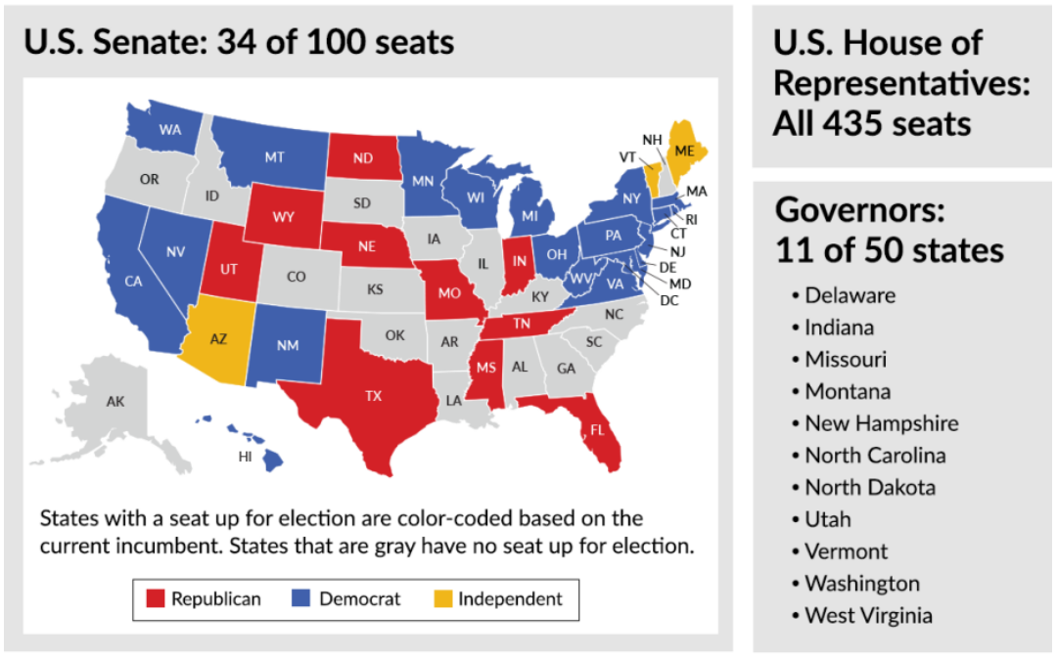
Congressional & Gubernatorial Seats Up For Election in 2024
Source: Ballotpedia

Slide 9

The US Economy is Bigger than Politics
Impartial Source of Information:
Joint Economic Committee of the US Congress

Slide 10
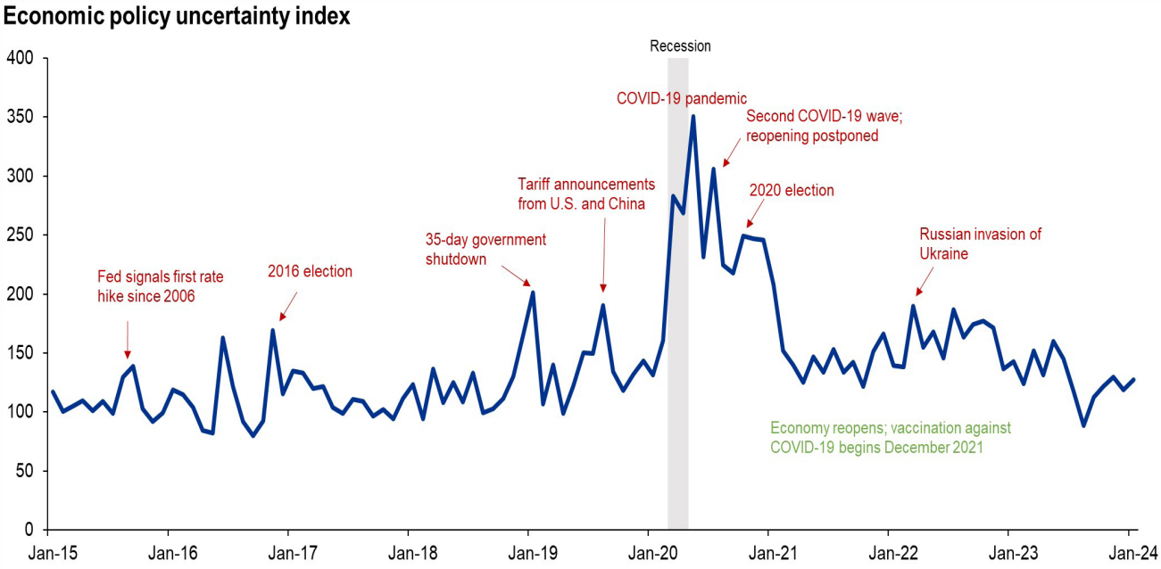
Impact of the Election on the Economy
Elections cause a spike in uncertainty
Source: KPMG | PolicyUncertainty.com | BEA | Bundy Group

Slide 11
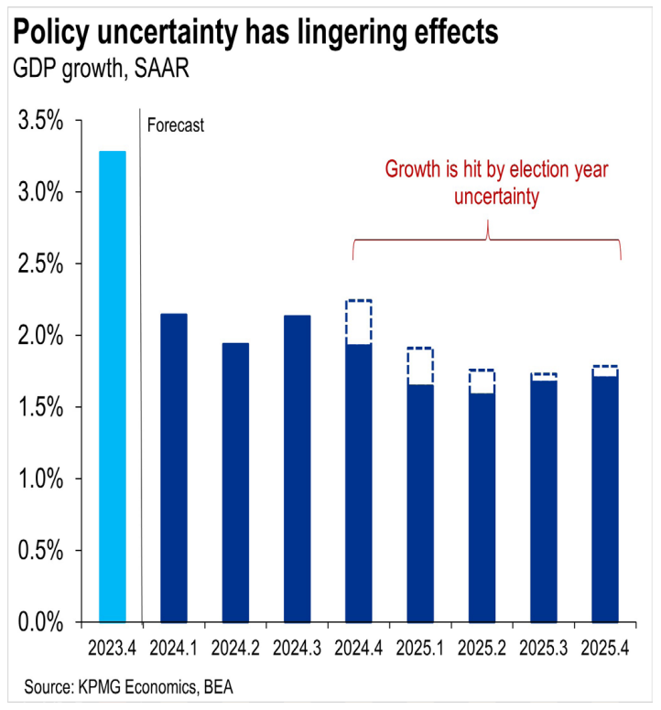
Impact of the Election on the Economy
Elections cause a spike in uncertainty
Source: KPMG | PolicyUncertainty.com | BEA | Bundy Group

Slide 12
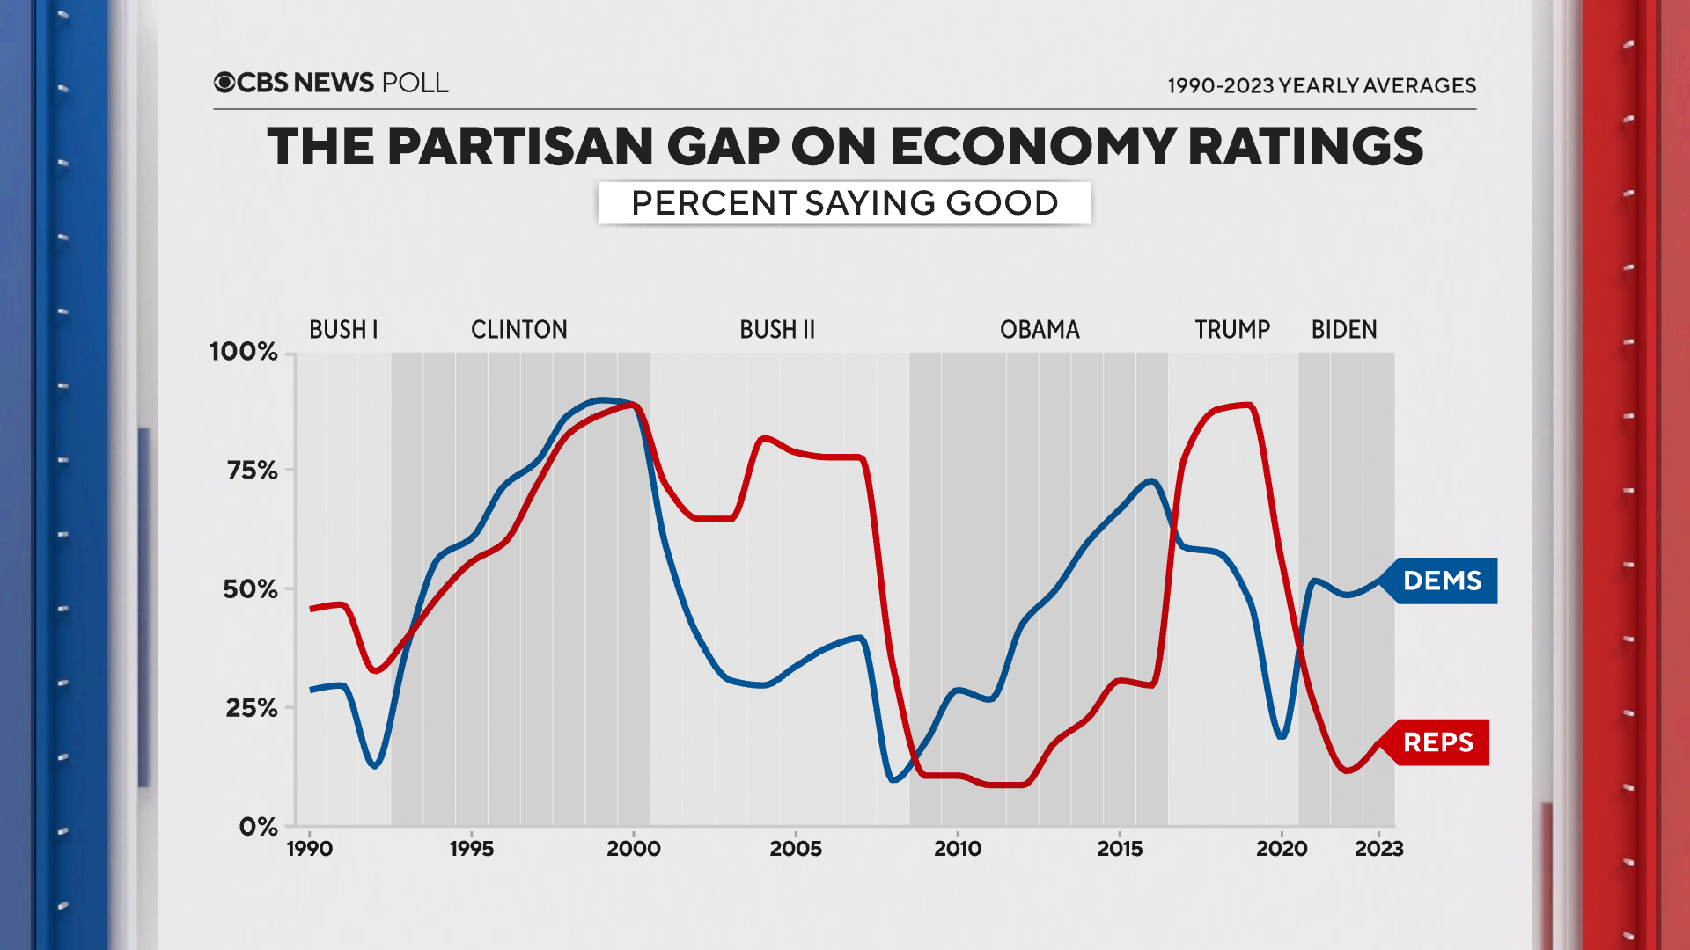
Source: CBS News | Bundy Group

Slide 13
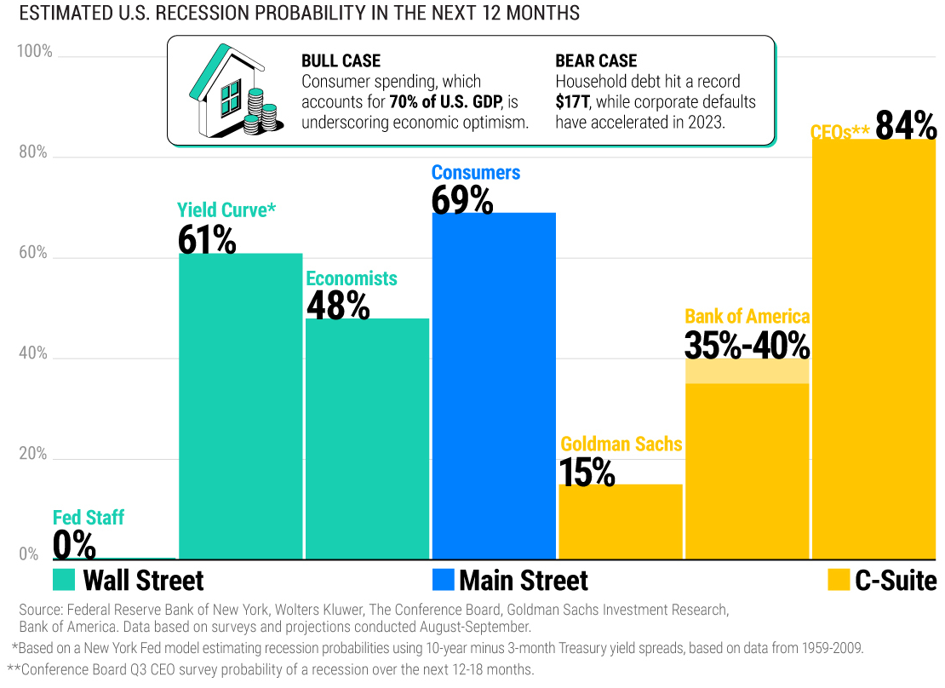
2024 Projections from Various Sources
Source: Visual Capitalist

Slide 14
Record High!
Source: Bureau of Economic Analysis| Bundy Group

Slide 15
Growth accelerated over the course of 2023
Source: Bureau of Economic Analysis| Bundy Group

Slide 16
Breaking Down the US Economy
Source: Bureau of Economic Analysis| Bundy Group

Slide 17
"Retail sales post steepest decline since March 2023!"
Latest data:
Where’s the catastrophe?
Source: US Census Bureau| Bundy Group

Slide 18
“Revenge Shopping Spree”
Pre-Pandemic Baseline
`
New Baseline
Covid Shutdown
Source: US Census Bureau| Bundy Group

Slide 19
Retail Activity Trend is Positive
Unsustainable Growth
3.5%
3.2%
Encouraging sign!
Great Recession
Pandemic Recession
Source: US Census Bureau| Bundy Group

Slide 20
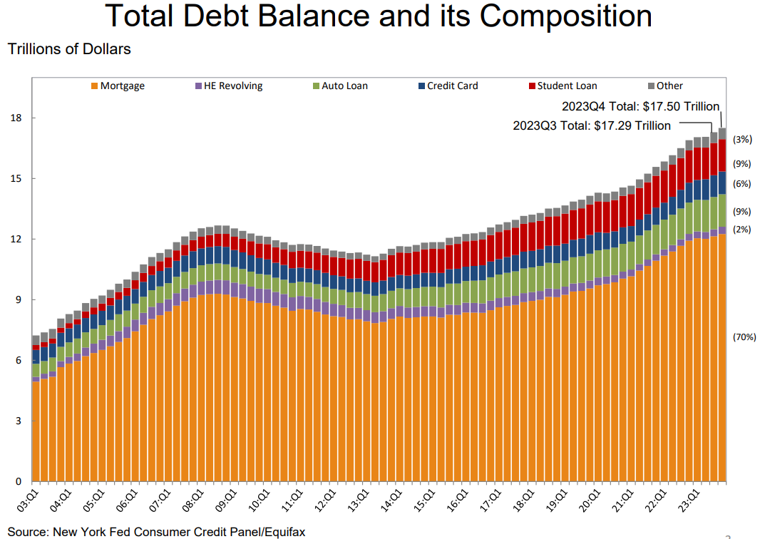
Distribution of American Consumer Debt
75% of mortgages locked in below 5%
55% have a rate below 4%
24% have a rate below 3%

Slide 21
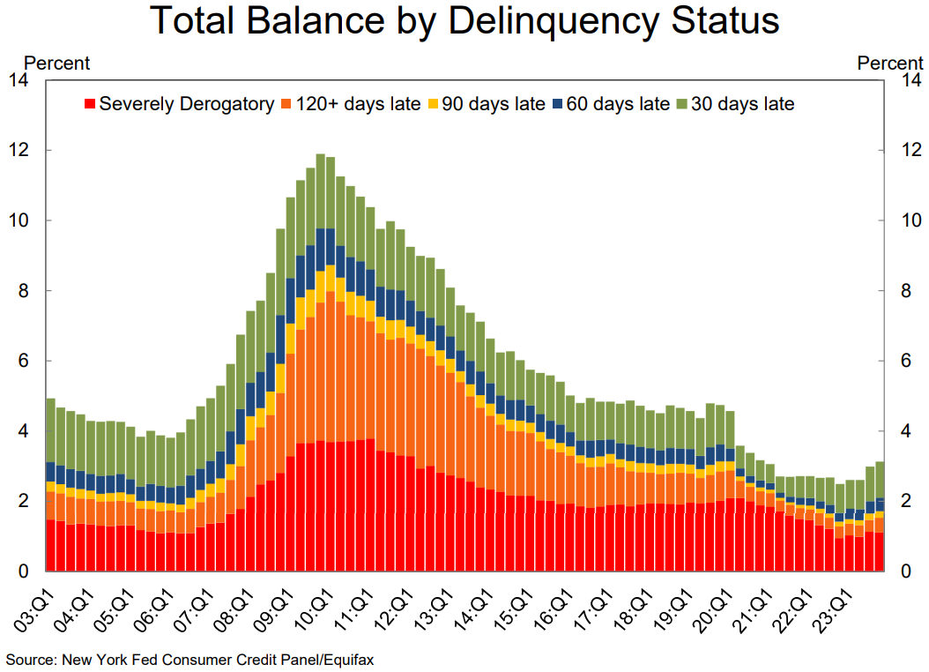
Total Balance by Delinquency Status

Slide 22
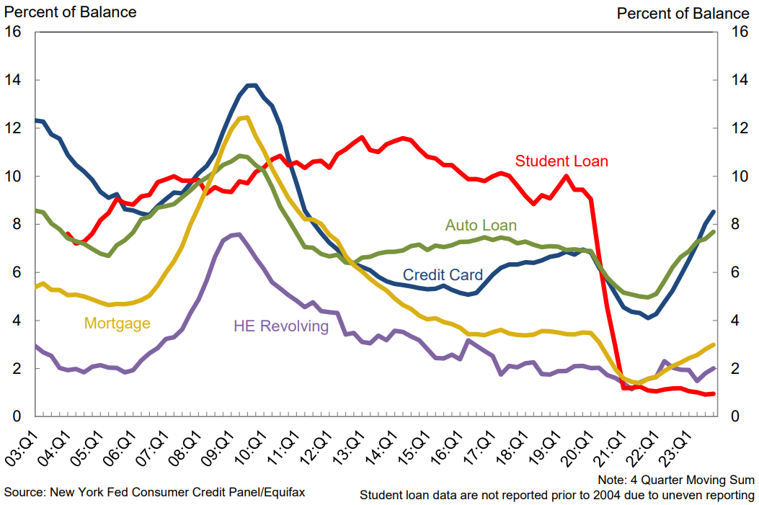
Transition into Delinquency by Loan Type
Credit Card & Auto loan delinquencies are of particular concern

Slide 23
US Industrial Production (B2B Economy)
Index, Not Seasonally Adjusted
Flat since early 2023
Source: Federal Reserve Board | Bundy Group

Slide 24
Industrial Economy Under Pressure
0.0%
-0.3%
Expect mild
contraction in the
near term
Source: Federal Reserve Board | Bundy Group

Slide 25
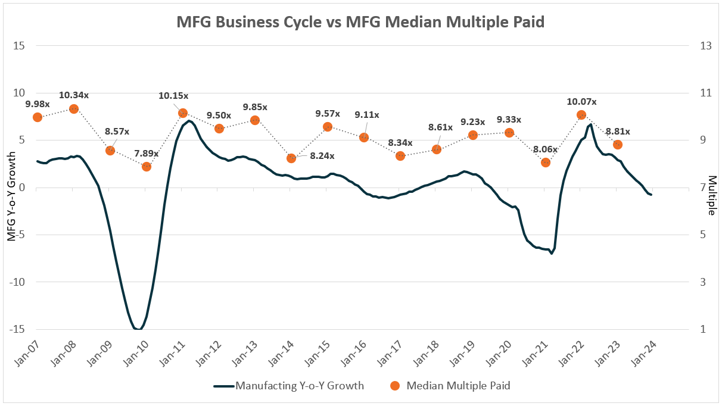
Business Valuations vs Economic Cycle
Source: Federal Reserve Board | Pitchbook | Bundy Group

Slide 26
How Do Leading Indicators Work?
Peak in Leading Indicator: 4Q09
Corresponding Peak in Data Series: 4Q10
How to Apply?
Seeing Around the Corner
Implication:12-month lead time
Industry Data
Leading Indicator
Source: Bundy Group

Slide 27
Leading Indicators: Capacity Utilization
Source: Federal Reserve Board | Bundy Group

Slide 28
Leading Indicators: Copper Prices
Source: Investing.com | Bundy Group

Slide 29
Leading Indicators: PMI
Source: Institute for Supply Management | Bundy Group

Slide 30
Consumer Prices – New (Higher) Normal
3.8%
New Likely Range (3% - 5%)
3 5%
Source: Bureau of Labor Statistics | Bundy Group

Slide 31
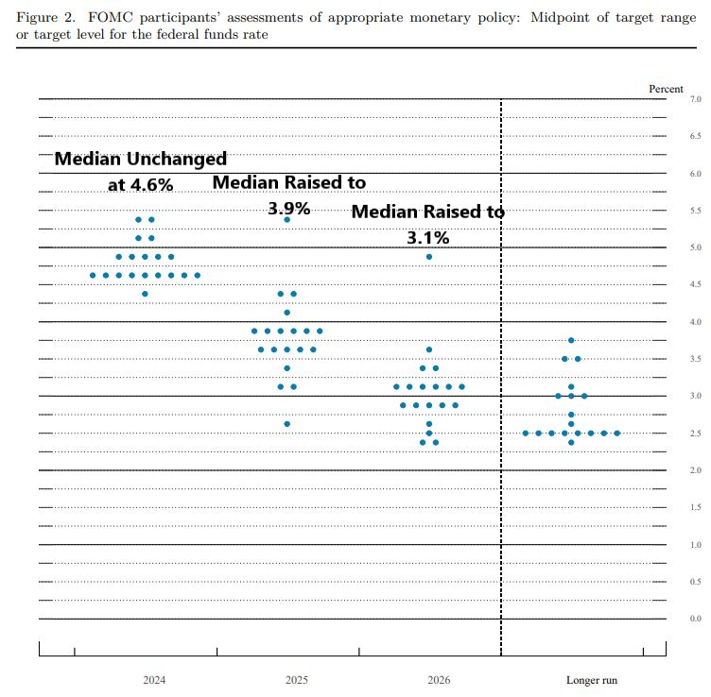
FED’s Interest Rate Policy Implications
Source: Federal Reserve Board | Bundy Group

Slide 32
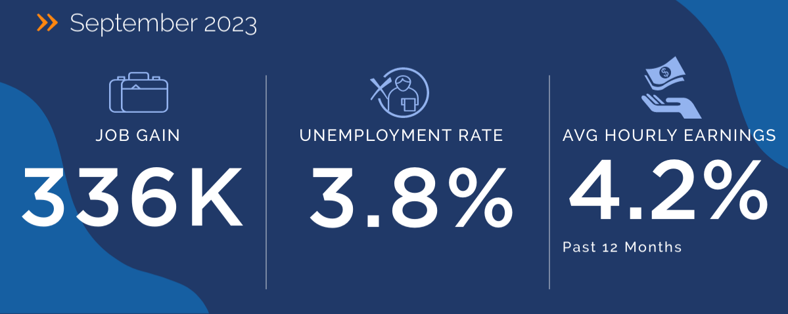
National Labor Market Performance
March 2024
303K
3.8%
4.1%
Past 12 Months
Source: Bureau of Labor Statistics | LaborIQ | Bundy Group

Slide 33






Labor Market Remains Tight
3.8%
Legal | 1.9%
Healthcare Practitioners | 1.0%
Management | 2.3%
Architecture & Engineering | 4.3%
Tech | 4.3%
Business & Financial | 2.0%
National Unemployment Rate
March 2024
Market Supply
Significant Shortage
Significant Surplus
Source: Bureau of Labor Statistics | LaborIQ | Bundy Group
Notes:
cpseea30.pdf (bls.gov)

Slide 34
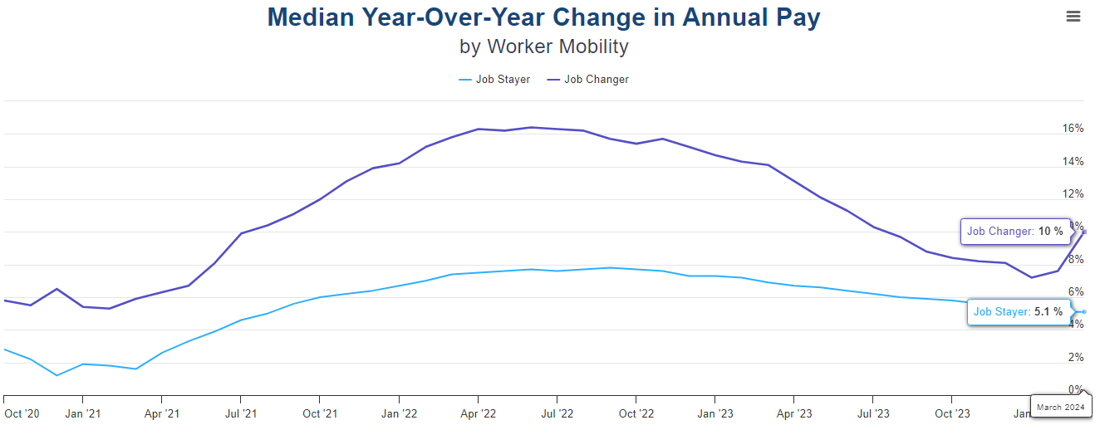
New Hire Wage Premium Still Exists
Source: ADP Research | Bundy Group

Slide 35
Jobs Added by Sector - March 2024
Education and health services | 88K
Government | 71K
Leisure and hospitality | 49K
Construction | 39K
Retail trade | 18K
Distribution | 9K
Professional and business services | 7K
Manufacturing | 0
1.8M (60%) of the 3M job added in 2023 were in the
healthcare, government, and leisure & hospitality sectors
Putting it in context….
Professional and business services added 250K jobs
Construction added 200K jobs
while Manufacturing added essentially no jobs in 2023
Source: Bureau of Labor Statistics | Bundy Group
Notes:
In April 2020 there were 5 unemployed individuals per job opening. Pre-Great Recession timeline 1.5 unemployed per job.
Since 2017 it has dropped below 1. Problem has only gotten worse over the last two years.
Employment Situation Summary Table B. Establishment data, seasonally adjusted - 2022 M10 Results (bls.gov)

Slide 36
The Labor Gap has Shrunk
Prominent Sectors
2.0M Education & Healthcare
1.7M Professional & Business
1.0M Leisure & Hospitality
1.0M Government
662K Retail Trade
601K Manufacturing
449K Construction
224K Wholesale Trade
8.8M
6.5M
Source: Bureau of Labor Statistics | Bundy Group
Notes:
Jan 2022- 11.3M
Over 10 million job openings – even if every one of the 6.3million unemployed workers took a job, there would still be positions to fill.
In December, there was 4.3 million quits. These workers are not heading for the sidelines, but they are leaving for better pay and/or benefits.
Quits pace nearly double the rate following the Great Recession.
Quits represent a threat to employee retention – finding new employees is more expensive than retaining existing ones.

Slide 37
Quits Back to Pre-Covid Level
2021/2022 surge:
4.5M+
2000 – 2019 average: 2.642M
2018/19 level
Source: Bureau of Labor Statistics | Bundy Group
Notes:
Jan 2022- 11.3M
Over 10 million job openings – even if every one of the 6.3million unemployed workers took a job, there would still be positions to fill.
In December, there was 4.3 million quits. These workers are not heading for the sidelines, but they are leaving for better pay and/or benefits.
Quits pace nearly double the rate following the Great Recession.
Quits represent a threat to employee retention – finding new employees is more expensive than retaining existing ones.

Slide 38
  Implications of today’s high interest rates:
  Cash is king, financing costs to remain prohibitive
  Customer retention/acquisition rates could drop due to lower demand
  Difficulty with decisions about R&D spending, hiring plans, inventory management
  Operational initiatives to consider:
  Growth by Market Share Gains
  Identify and remove unnecessary steps to increase efficiency and throughput
  Protect margins by
    Reducing waste and energy use
    Renegotiating transportation contracts
  Focus on employee retention
Navigating the Current Macro Landscape
Source: Bundy Group

Slide 39

CONNECT WITH ALEX ON LINKEDIN
Q&A
ALEX@BUNDYGROUP.COM
512-743-9017
BUNDYGROUP.COM
April 2024
Presented by
Alex Chausovsky

