Slide 1
Annual Member Meeting -- AGENDA
Call to Order, Brian Holland, CLA Board Chair
Minutes – Approval of 2023 Annual Meeting minutes
Financial Report – Brian Wallace, President/CEO
CLA Board of Directors Election –Amanda Konczal, Chair Nominating Committee
Association Program Updates, Brian Wallace, President/CEO
LaundryCares Foundation Update, Dan Naumann, EVP of LCF
New Business
Time & Place of Next Meeting
Adjournment

Slide 2
Minutes
CLA Annual Membership Meeting – May 11, 2023
Rancho Bernardo Inn – San Diego, California
Call to Order – Brian Holland, CLA Chair – Mr. Holland called the meeting to order at 8:30a. All registered attendees present.
Motion to approve minutes from 2022 meeting minutes by Mr. Finkelstein; seconded by Mr. Balestracci and approved unanimously.
Financial Report – Mr. Wallace presented a report on association finances including 2022 audited results. Motion to approve financial report by Mr. Marrazzo; seconded by Mr. Rhodes and approved unanimously.
Staff Reports – Mr. Wallace provided informational updates on several association programs and initiatives.

Slide 3
Minutes
CLA Annual Membership Meeting – May 11, 2023
Rancho Bernardo Inn – San Diego, California
CLA Board Election – Mr. Marrazzo, Nominating Committee Chair, presented a slate of the following candidates for election to serve on the 2024 CLA Board of Directors: Paul Hansen, Alex Smereczniak, Mark Vlaskamp and Amanda Konczal, Ryan Spicer and Jennifer Whitney. The slate was approved by acclamation unanimously.
No Old Business or New Business was presented.
Motion to adjourn by Mr. Brunckhorst; seconded by Mr. Harris and approved unanimously.

Slide 4
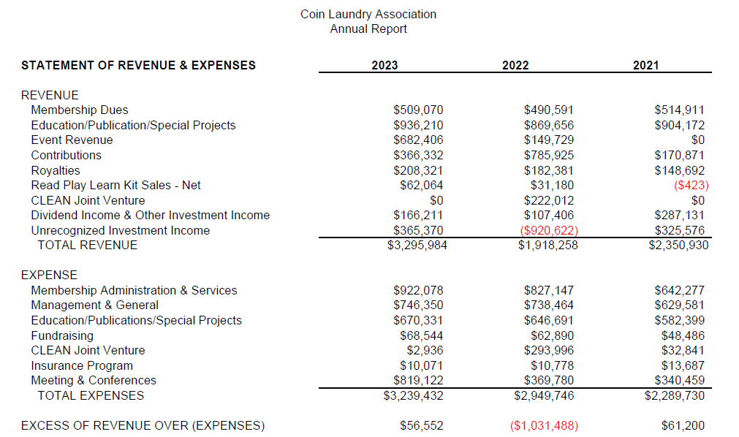
Financial Report

Slide 5
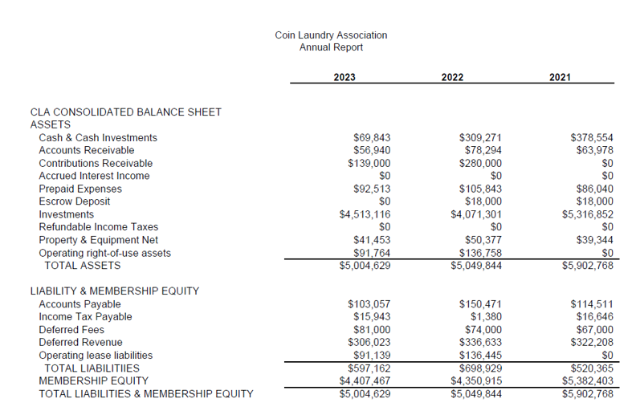
Financial Report

Slide 6
Board of Directors Election – 2025 Slate
Alaa Elbanna (Store Owner)- New
Kevin Butorac (Distributor)- Incumbent
Yvette Morton-Williams (Store Owner)- Incumbent
Jamie Sewell (Store Owner)- New
Alex Harris (Distributor)- Incumbent
Chris Schultz (Distributor)- New
Peter Mayberry (Store Owner)- New
Ross Dodds (Store Owner)- New

Slide 7
Association Program Updates
Association Branding Refresh
Strategic Priorities
Programs & Benefits
Advocacy Update
Industry Advisory Council

Slide 8
Brand Refresh

Slide 9
Brand Refresh

Slide 10
Strategic Priorities
Enhance Value Proposition for Membership
New benefits and programs; more cost-savings and networking opportunities
Frictionless Digital Experience
CRM Platform, Event Registration, Website Refresh
Improvements to Marketing Communications
Agency support into Year 2, PlanetLaundry refresh, social media content
Grow Live Events
New Investor Workshops, WDF Conference, Clean 2025
Implement New Voices Policy Statement
Welcome aligned influencers, consultants and service providers

Slide 11
Programs & Benefits
Membership Value Task Force
Premium Cash-Back Credit Card Offering
CLAdvantage Rewards Program
Peer-to-Peer/Mastermind Pilot
Women’s Laundry Network
Industry Advisory Council

Slide 12
Advocacy Update
2023-2024 Issues:
Microfiber Filtration Requirements
California Win!
Illinois Win – for now…
Sales Tax Exemption Protection
Win in Nebraska
Win/Clarification in Kentucky
Monitoring Maryland, Alaska
NJ DOL Strategic Enforcement on Laundromat Industry
DOE regulation of Commercial Dryers
Natural Gas access in new commercial buildings
NYC – Laundry Advisory Task Force – set to disband in 2024
Extra Thanks to our ELITE Strategic Corporate Ally Partners: Alliance Laundry Systems, cents, Dexter Laundry, Girbau North America

Slide 13
Industry Advisory Council
The CLA Industry Advisory Council will pursue a mission of collaboration toward promoting progress on behalf of the laundromat industry in the following areas of focus:
Provide leadership and guidance to CLA in pursuing its legislative and regulatory advocacy on behalf of the commercial laundry market.
Promote the essential community value of efficient, affordable and readily available laundry services to a diversified demographic.
Serve as ‘voice of the market’ by leveraging subject matter expertise to create valuable content regarding emerging trends for the industry.
Exercise thought leadership by identifying best practices for laundromat operation, offering a vetted and responsible vision of first-time laundromat ownership to potential investors – and otherwise promote CLA as the authoritative and preeminent resource for the industry.

Slide 14
Participant | Company
Russ Arbuckle | Wholesale Commercial Laundry Equipment SE
Sharon Brinks | The Laundry Station
Dave Derby | Southeastern Laundry Equipment
Jason Fleck | Laundrylux
Matt Gibbs | A C Power Company
Joel Jorgensen | Girbau North America
Steve Lach | Action Laundry
Craig Madson | Alliance Laundry Systems
Pablo Marvel | cents
Mike Nelson | Dexter Laundry
Bryan Rausch | Dexter Laundry
Greg Reese | Alliance Distribution
Courtney Satterlee | GB Laundry Brokers/Laundryworks Investments
Jamie Sewell | Clean Vibes Laundry Company
Stan Sugarman | OZ Laundry
Shereka Webber | Alliance Laundry Systems
Jason Worme | Star Laundromats

Slide 15
LaundryCares Foundation
News Story on Recent Free Literacy & Laundry Day Event: https://spectrumnews1.com/wi/milwaukee/news/2024/03/13/milwaukee--mighty-small-moments--learning

Slide 16
Sponsorship Contributions

Slide 17
Sponsorship Contributions

Slide 18
In-Kind Donors
RYAN SPICER

Slide 19
LaundryCares Foundation

Slide 20
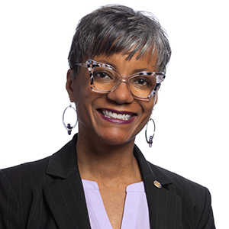
Peer Testimonials
Yvette Morton Williams

Slide 21
LaundryCares Foundation

Slide 22
Commitments to Action

Slide 23
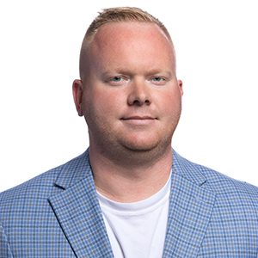
Peer Testimonials
Ryan Spicer

Slide 24
Tom Rhodes
Sunshine Laundry Centers

Slide 25
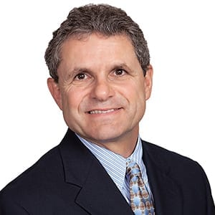
Peer Testimonials
Brian Grell
President
LaundryCares Foundation

Slide 26
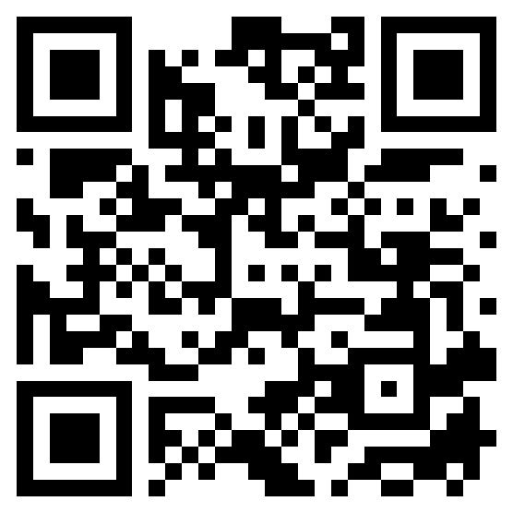
Commitments to Action
Donate
Install an RPL space
Join LCF Network
www.laundrycares.org

Slide 27
LaundryCares Foundation

Slide 28
Bylaws Change
ARTICLE VI – Directors, Section 1
The ratio of voting Directors representing Active members which are manufacturers, distributors, operators, and others conducting business or professional activities related to the self-service laundry industry shall be determined by the Board of Directors as required, provided that at least 50% of the total number of Directors shall be store owner operators, and at least two (2) Directors shall be manufacturers, at least two (2) Directors shall be service providers, and at least two (2) Directors shall be distributors. not to exceed 50% less than three (3) voting Board members representing each of the manufacturers and distributors group, and in no case shall there be less than 50% of the total Board represented by the store owner operators.

Slide 29
Time & Place of Next Meeting
August 25, 2025
Clean 2025
Orlando, Florida

